Slide 1
Information Asset Owner Training Refresh
Chapter 8: Security Incidents & Data breaches

Slide 2
Security Incidents & Data breaches
Security Incidents & Data breaches
Examples of types of information & cyber breaches
Examples of real-world breaches and incidents
Potential Impact and consequences of breaches
01
How to avoid incidents and breaches
02
Reporting & Managing Incidents and Breaches
03
Scenario 4
04
Summary of key learning points – Video
05
08
06
07
08

Slide 3

Security Incidents & Data breaches (1)
As an IAO being able to identify and understand specific actions, weaknesses in control or potential vulnerabilities and threats that may lead to an incident or breach, allows you to apply measures to mitigate against.
However, learning from past incidents can strengthen governance, promote a security culture, and improve risk management practices.

Slide 4
Security Incidents & Data breaches (2)
What are Incidents & breaches
You should be informed of all incidents, especially involving information compromise for information assets within your area of responsibility. Data breaches that risk individuals' rights and freedoms must be reported to the ICO within 72 hours. GDPR compliance requires preparation and mitigation measures for such breaches.
What are security incidents & breaches?
A security incident involves the attempted or actual unauthorised access, use, disclosure, modification, loss, or destruction of an asset in violation of security policy.
A breach of security is defined as an incident where the procedures for managing the organisation's information or equipment have been violated or ignored.
What is a personal data breach?
A personal data breach is a breach of security leading to the accidental or unlawful destruction, loss, alteration, unauthorised disclosure of, or access to, personal information transmitted, stored or otherwise processed, according to the Information Commissioner's Office (ICO).

Slide 5
Examples of types of information & cyber breaches (1)
This list is not exhaustive
Information Breaches
External Disclosure: Sensitive information is shared with or exposed to unauthorised individuals outside the organisation intentionally, unintentionally or maliciously.
In Transit: Sensitive information in physical documentation is disclosed during transfer from one location to another.
Internal Disclosure: One or more persons employed by or contracted to the organisation receives, sees or hears sensitive information with no legitimate reason to do so.
Redaction: Sensitive information that should have been removed remains accessible to those unauthorised to view or is held on an unauthorised platform. This can involve personally identifiable information (PII), financial details or sensitive business data.
Verbal: Sensitive information is shared verbally via conversations, phone calls, meetings, or any situation where confidential information is discussed in an unsecure environment.
Waste: Physical documents containing sensitive information are not correctly or securely disposed of. This can expose data to unauthorised individuals, leading to potential misuse or unauthorised access.
Written: Sensitive information is shared through handwritten or printed documents such as notes, letters, reports, or any written material not properly secured that falls into unauthorised hands.

Slide 6
Examples of types of information & cyber breaches (2)
This list is not exhaustive
Cyber Breaches
Cyber Access Rights: Unauthorised individuals gain access to systems/network/data. By exploiting vulnerabilities, using stolen credentials or abusing granted access rights.
Data Transfer Security Issue: Sensitive data is transmitted over network channels without encryption or security measures. Can lead to interception, unauthorised access or modification.
Social Engineering/ Malicious Software Phishing/Spear phishing/Whaling: A targeted system or device, attacks staff with fraudulent emails, to deceive recipients into clicking on malicious links. Use of malware, viruses, worms, trojans, ransomware etc.
Leak: The unauthorised disclosure of sensitive, confidential, or protected information, either intentionally or accidentally. This can be a deliberate leak of sensitive information to the press.
Social Media: Sensitive, information is shared or leaked via social media platforms. Posting sensitive details e.g. on WhatsApp or in private messages between colleagues using social media.
External Misuse: Unauthorised individuals outside the organisation such as hackers or cybercriminals either attempt to access or gain access to systems.
Internal Misuse and Breach: Unauthorised individuals within the organisation abuse access rights to data/ systems. This could involve accessing sensitive information without authorisation, altering data for personal gain or leaking sensitive information.

Slide 7

Examples of real-world breaches and incidents (1)
Security incidents affect an organisation’s assets, potentially resulting in significant consequences. These real-world examples which occurred in the public sector illustrates how breaches can happen when security policies are not followed, and the consequences can be damaging to individuals and the organisation.
Breach 1. Physical Security Breach – sensitive waste
In February 2022, a government organisation experienced a security breach when 14 bags containing sensitive documents was left unsecured for 18 days, after a scheduled shredding service missed the collection. The bags included staff and other individuals medical and vetting information.
The bags, some unsealed were left accessible to both staff and unauthorised individuals. Although some staff challenged individuals seen handling documents, the incident was not reported to security. This breach exposed sensitive and personal information.
This lapse in security protocols could have led to significant distress, exposing staff and other individuals to the risk of identification and potential intimidation, including their family members.

Slide 8

Examples of real-world breaches and incidents (2)
Breach 2. Personal Data breach
A UK police force faced a major data breach when an employee, responding to a freedom of information request, inadvertently included a hidden worksheet with sensitive data in a workbook. This mistake exposed the personal details of over 9,000 employees online, including surnames, initials, rank, and role. This breach caused serious safety concerns for the individuals and their families.
Upon reporting the breach to the ICO, the event was described as a 'perfect storm of risk and harm,' emphasizing the human impact of inadequate data security. The police force was fined £750,000, reduced from £5.6 million due to public sector considerations. The ICO stated that this incident serves as a reminder for all organisations that simple procedures could have prevented the breach.

Slide 9
Potential Impact and consequences of breaches
An information loss can cause harm or distress to individuals and have an impact on the organisation. Here are some examples of the potential consequences of breaches:
Personnel Risk: Data breaches can expose sensitive personal information that could be exploited for identity theft and fraud. In some cases, can be life threatening.
Regulatory Consequences: The ICO often launches investigations, and the organisation can face penalties under the UK GDPR.
Reputational Damage: Public and parliamentary scrutiny over cybersecurity practices. Trust in Government is broken.
Operational Disruption: Internal reviews and audits / temporary suspension of certain digital services, affecting workflow and morale.
Legal/financial: damage to the organisation.

Slide 10



How to avoid incidents and breaches (1)
These incidents could have been avoided. So, what action can you take to prevent these types of security breaches?
1. Ensure staff within your area of responsibility understand the process for disposal of sensitive information securely and follow your organisation’s procedures for secure shredding of waste or secure disposal. If sensitive information is left unattended it should be stored away securely and reported immediately to security.
2. Ensure staff within your area of responsibility understand they must never share official information on unauthorised platforms or systems. If information is shared accidentally on an insecure platform, the incident should be reported immediately to security.
3. Ensure staff within your area of responsibility handle information securely based on its classification and the ‘need to know’ principle and apply vigilance to always report potential breaches to security as soon as they become aware of them.

Slide 11

How to avoid incidents and breaches (2)
Sharing information safely
Some actions staff can take to ensure they are sharing information safely include:
Check for hidden data in attachments
Check the recipients are correct and that they are authorised to receive the information
When emailing multiple recipients, use bulk email services, mail merge, or secure data transfer services where available
Always check sending emails to the correct recipient and be extremely careful when using the blind copy function (BCC)
Do not use the BCC copy when sending sensitive information to multiple recipients via email. Consider sending individual emails instead
For further information regarding how staff can share securely visit the Share with Care website

Slide 12

Reporting & Managing Incidents and Breaches
Staff should understand their responsibilities and what they need to do in their department to report a potential incident or breach. Any breaches involving personal information must also be reported to the data protection team.
Managing incidents and breaches:
An organisation needs a well-established Incident Response Plan to manage breaches and security incidents effectively, aiming to prevent further damage.
Each organisation follows its own process for breach-reporting and investigation between the Data Protection Officer (DPO), cyber, and security teams. Many breaches may involve personal data, cyber elements, or physical components, adding complexity to their nature.
Therefore, it is essential for an IAO to ensure collaboration between these teams, especially during incident investigations, to gain a comprehensive understanding of the breach's cause and implement measures to mitigate future incidents. Effective incident response requires cooperation between the teams, with clearly defined roles and responsibilities to handle incidents and learn from them for future prevention.

Slide 13
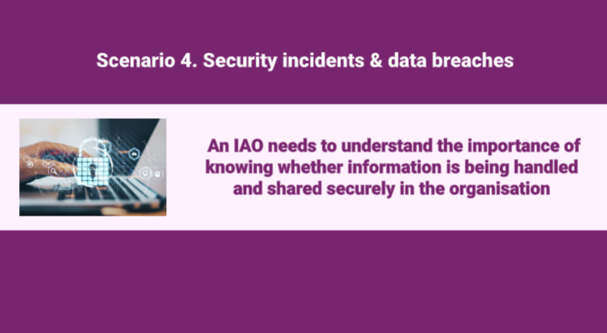
Scenario 4:
Video
Click on the image to play the Video.
If the video doesn't open in full screen automatically, click the full screen icon (⛶) in the bottom-right corner of the video player to enlarge it.
Once you have finished viewing the video click outside the image to move to the next slide.

Slide 14
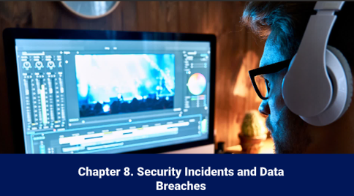
Summary of key learning
Video
Click on the image to play the Video.
If the video doesn't open in full screen automatically, click the full screen icon (⛶) in the bottom-right corner of the video player to enlarge it.
Once you have finished viewing the video click outside the image to move to the next slide.

Slide 15
You have completed this chapter
Please start chapter 9

