Slide 1
Information Asset Owner Training
Chapter 6: Security

Slide 2
Security
Security
Information Security
Cyber Security
Physical Security
Personnel Security
6

Slide 3
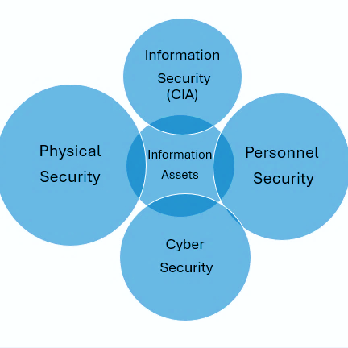
Security
Holistic Security Overview
Effective information security relies on a comprehensive, holistic approach that ensures all security controls are appropriately and proportionately implemented in line with the associated risks.
Information, Cyber, Personnel and Physical Security are interrelated and dependent on each other. The most effective way to secure information assets is to use a combination of physical, information/cyber and personnel security measures.
For example, installing an expensive ID pass and PIN access control system for entry to an office is of little use if recruitment checks are not properly assessing who is issued with a pass.

Slide 4
Information Security (1)
Confidentiality, Integrity, and Availability (CIA)
IAOs have a crucial part to play in information security, having responsibility for and authority over the information within their area of responsibility, giving them a clear view of key information risks and allowing them to formally accept, mitigate, or decline those risks, including partners.
Information security includes a combination of technical tools, policies, processes and people which are all devised to protect, prevent, detect and mitigate attacks and threats to sensitive information, whether digital or non-digital information.
Information Security is built on the core principles of Confidentiality, Integrity, and Availability (CIA);
Principle | Protection | Risk
Confidentiality | Ensuring that information is only accessible to authorised individuals | A loss of Confidentiality results in unauthorised access or disclosure of information leaks/loss of information/theft
Integrity | Ensuring that information remains accurate and unaltered (unless required) | A compromise to the Integrity of information results in inaccurate, incomplete or corrupted data and information
Availability | Ensuring that information is available when needed to authorised individuals | A lack of Availability results in authorised users being unable to access information when required

Slide 5

Information Security (2)
Adopting CIA principles helps identify risks to assets, indicating which aspect to prioritise for protection. However, all three principles are applied for complete security coverage.
Effective information security requires a comprehensive and holistic approach, with collaboration from teams such as Digital and Data, Cyber, Security, Assurance, and Knowledge and Information Management (KIM), to manage risks effectively.
As the IAO responsible for overseeing information risk, you will receive support from these teams in identifying, mitigating, and reporting risks. It may be necessary to provide guidance or escalate matters at Board level. Additionally, extra resources might be required to implement mitigation measures and controls.

Slide 6
Information Security (3)
Artificial Intelligence Systems and Services
The use of an AI system or service in connection with information assets can bring valuable benefits in terms of information exploitation, knowledge and information management, productivity and process improvements.
Information Asset Ownership will become even more important as organisations need access to high-quality and well-governed information for effective AI outcomes, increasing the demand for clear ownership. IAOs should become informed about AI and how it could impact their assets.
Over time, we expect IAOs to become increasingly important in enabling the ethical, safe and explainable use of government information in AI systems.
Prior to allowing an AI service access to information, an IAO should be satisfied that the service has been assessed to ensure it does not pose a risk to information security, data quality or data privacy.
With particular consideration being given to whether:
The AI system/service complies with the government’s Secure by Design principles
A data protection impact assessment has been carried out (if the dataset contains personal data)

Slide 7

Information Security (4)
Classifying and handling information
The Government Security Classification Policy provides an administrative system for HM Government and its partners to protect information assets against prevalent threats. Classification is based on the potential impact of the compromise, loss, or misuse of information.
The policy covers procedures for creating, sharing, and destroying information, setting the baseline security controls and behaviours necessary to protect information at each classification tier.
The three tiers of classifications are OFFICIAL, SECRET and TOP SECRET. These classifications are determined by evaluating the value and risks associated with the information asset, including the potential impact from compromise, loss, or misuse. Higher classifications require additional security measures to prevent unauthorised disclosure or misuse of the information.

Slide 8
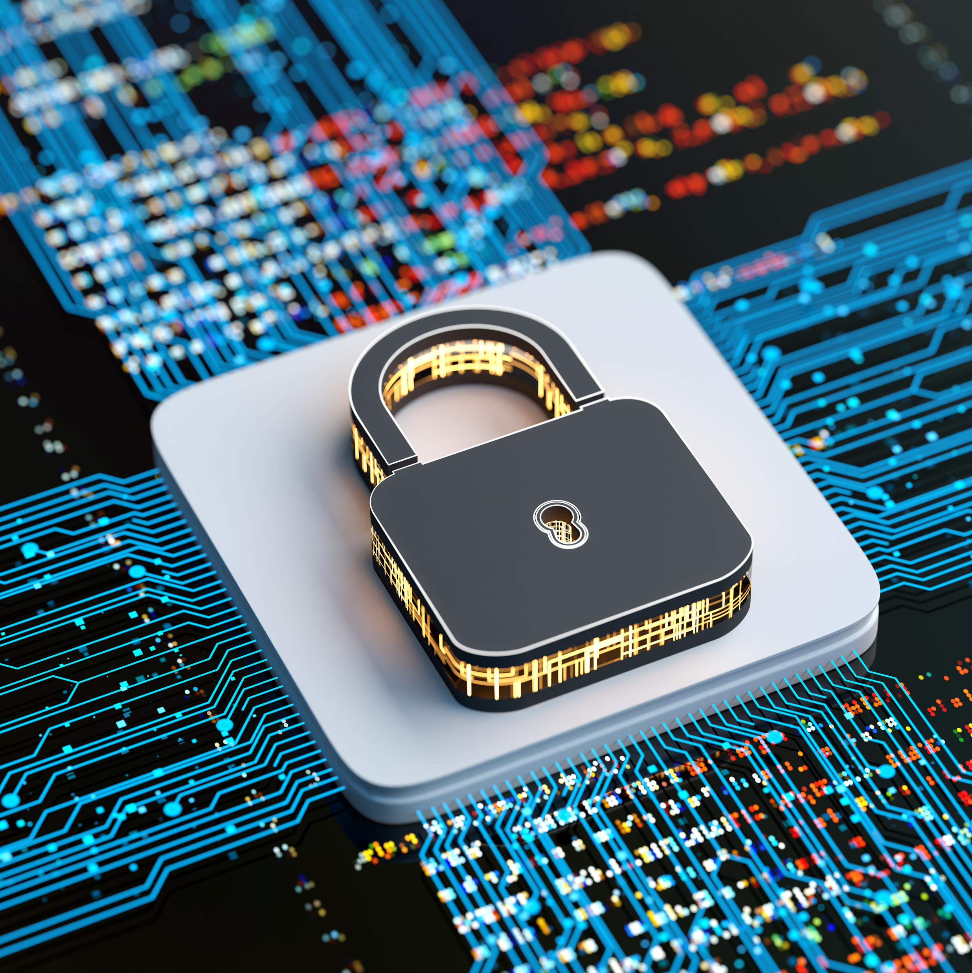
Cyber Security (1)
What is Cyber Security?
Cyber security helps individuals and organisations prevent cyber-attacks. It protects devices and services, both online and at work, from theft or damage. Government organisations are increasingly targeted by cyber-attacks, to steal information, or disrupt services. Protecting information is crucial to prevent financial or reputational damage.
IAOs don’t need to be technical experts but do need to know enough about cyber security to have constructive discussions with key staff, for confidence that cyber risk is being appropriately managed. An IAOs approach to cyber security should be strategic to maintain operational resilience during incidents.
Cyber security focuses on preventing hackers penetrating your IT systems
Cyber resilience is the ability of an organisation to protect itself from, detect, respond to and recover from a cyber attack

Slide 9
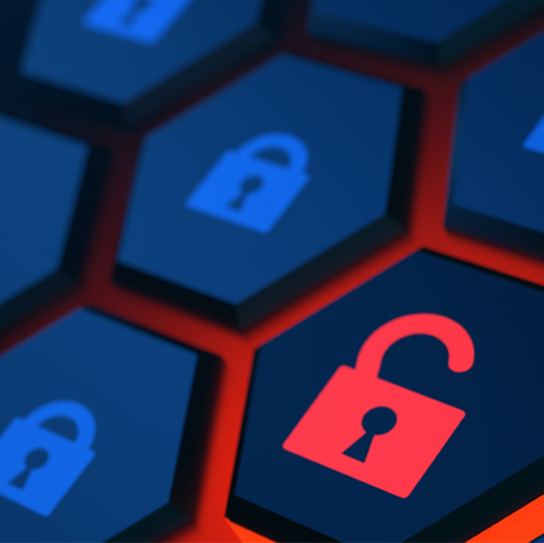
Cyber Security (2)
Cyber Risk
An IAO needs to ensure that cyber risks to delivering business and services are identified, evaluated, and mitigated in line with the business risk-appetite.
This includes:
Understanding risks that cyber incidents present to delivery of the business strategy
Ensuring the business has adequate cyber resilience to prevent, detect and respond to cyber attacks
A cyber strategy should align with the business strategy to minimise risk, financial impact, and reputational damage.
It must be integrated into risk management and decision-making processes, with all business units understanding their cyber security responsibilities.
For example, see the next slide:

Slide 10






Cyber Security (3)
Technical team:
secure data and systems with appropriate controls such as firewalls, Antivirus/Malware Protection etc
Staff:
should receive regular training and understand policy & guidelines
Communications:
work with the IAO to prepare statements for incidents such as disruptions or breaches
The cyber security
team:
establish policies to prevent unauthorised access
Procurement team:
assess cyber risk in contracts and manage supply-chain governance
All business areas:
implement effective cyber security measures

Slide 11
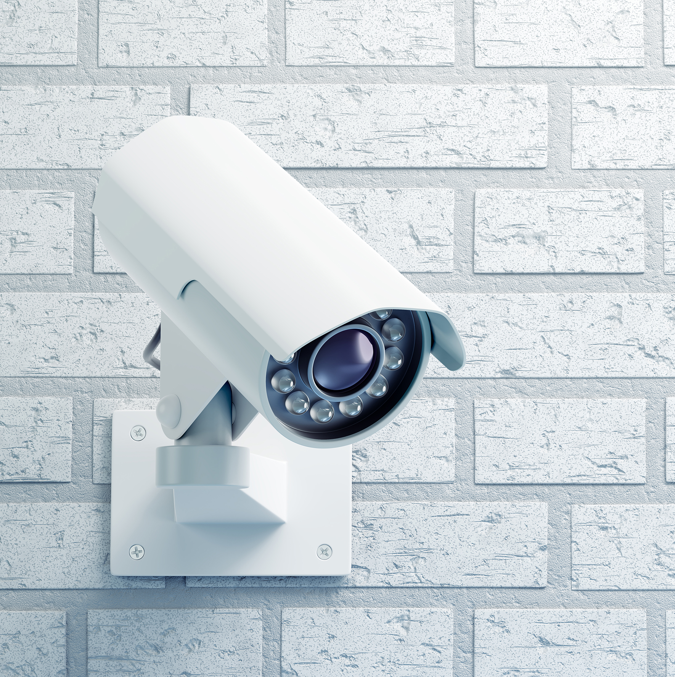
Physical Security (1)
What is Physical Security?
Physical security involves measures to protect assets such as people, government property, buildings/estates and information from threats such as theft, unauthorised access, and natural disasters.
It includes securing entrances, surveillance systems, access control, secure storage, staff ID passes and other techniques to deter, detect, and respond to intrusions.
Physical security is a key area for IAOs to understand because it plays a crucial role in safeguarding both digital and non-digital assets. Physical threats such as theft, unauthorised access, or environmental damage can be just as damaging to an organisation’s information confidentiality, integrity and availability.

Slide 12

Physical Security (2)
IAOs must ensure that appropriate physical controls are in place to protect information to:
Prevent unauthorised access to physical sites
Protect hardware and infrastructure
Safeguard printed information
Environmental and disaster protection

Slide 13

Personnel security
Personnel security ensures staff safety during government business and makes them aware of their role in protecting information. It includes policies and procedures to prevent employees and contractors from misusing their access to assets.
This involves implementing measures such as pre-employment screening, vetting, security training, and access control systems to ensure that individuals are granted access to information strictly on a need-to-know basis.
Certain HMG positions or buildings require higher levels of security clearance for access to sensitive information or assets.

Slide 14
You have completed this chapter
Please start chapter 7

