Slide 1
Information Asset Owner Training
Chapter 5: Legal & policy requirements

Slide 2
Legal & policy requirements
Legal & Policy Requirements
UK GDPR and the Data Protection Act
The 7 data protection principles
Data Protection Impact Assessments (DPIAs)
01
Record of Processing Activities (ROPA)
02
Data sharing agreements
03
Policy requirements
04
05
05
06
07

Slide 3
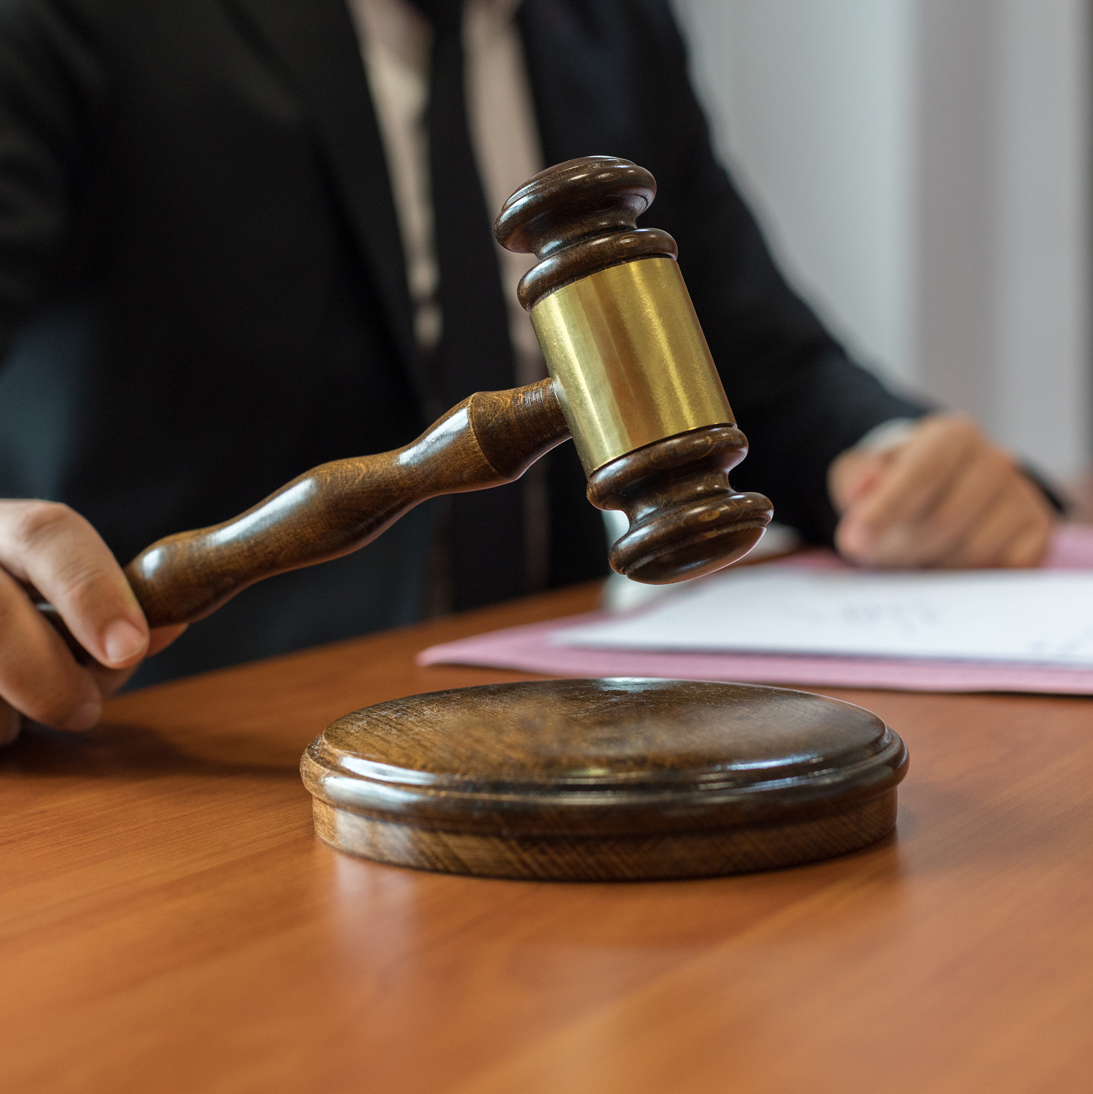
Legal and policy requirements (1)
Introduction
As an IAO, you must ensure that your area of responsibility complies with relevant legal, regulatory and policy requirements covering information governance. This includes managing and safeguarding information and providing public access to information where appropriate.
Go to the next slide to discover what this includes.

Slide 4
Legal and policy requirements (2)
Relevant legislation
Freedom of Information Act 2000 (FOI)
And Environmental Information Regulations 2004 (EIR) – This legislation gives citizens the right to request recorded information from the Government and other public authorities. If a member of the public wants to obtain information that a public authority holds about themselves (personal data) they can submit a Subject Access Request (SAR) under the UK General Data Protection Regulation (UK GDPR).
Public Records Act 1958
A legal framework for preservation, management, and access to public records in the UK. The 20-year rule is when government records selected for permanent preservation are transferred to The National Archives and made publicly available.
The Civil Service Code
A formal document that constitutes part of the Terms and Conditions of employment for all Civil Servants. It sets out the core values and standards of conduct that Civil Servants are expected to uphold in their daily responsibilities, ensuring they act with integrity, honesty, objectivity, and impartiality.

Slide 5
Legal and policy requirements (3)
Relevant legislation
Official Secrets Act 1989
The act to prevent espionage and unauthorised disclosure of official information, safeguarding national security. The Act addresses offences related to spying, sabotage, and related crimes. Including the unlawful disclosure of government information by current and former employees of the security services and Crown Servants.
Computer Misuse Act 1990
The act criminalises unauthorised access to computer systems and data, as well as damaging or destroying them. Computer abuse includes activities such as cyber-bullying, hacking and identity theft.
Data Protection law
(UK General Data Protection Regulation (UK GDPR), the Data Protection Act 2018 and the Data (Use and Access) Act 2025).
The Data (Use and Access) Act received Royal Assent on 19 June 2025, and changes some of the requirements. For the latest information please see the ICO guidance.

Slide 6
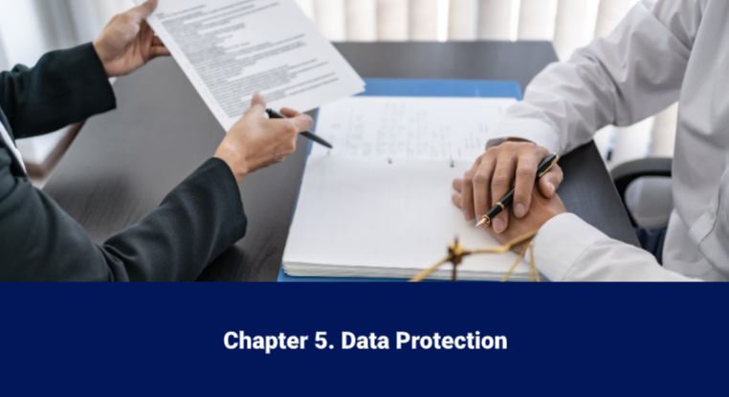
UK GDPR and the Data Protection Act
Video
Click on the image to play the Video.
If the video doesn't open in full screen automatically, click the full screen icon (⛶) in the bottom-right corner of the video player to enlarge it.
Once you have finished viewing the video click outside the image to move to the next slide.

Slide 7
The 7 data protection principles
Lawfulness, fairness, and transparency: there must be a valid legal basis for processing personal data and organisations must be open and honest about their intended processing
Purpose limitation: Personal data should be collected and processed only for specified, explicit, and legitimate purposes
The proper handling and processing of personal data is a legal obligation. Failure to adhere to these obligations could result in a public reprimand, financial penalties reputational damage and operational disruption. Your own organisation will have a Data Protection Policy. Check with your Data Protection Officer (DPO).
Data minimisation: Only the minimum amount of personal data needed to fulfil your purpose should be collected and processed
Accuracy: Personal data should be accurate and kept up to date, where necessary
Storage limitation: Personal data should not be kept for longer than necessary for the purposes for which it was collected
Integrity and confidentiality (security): Personal data should be processed securely using appropriate technical and organisational security measures
Accountability: Controllers must be able to demonstrate that they are complying with the data protection principles

Slide 8

Data Protection Impact Assessments (DPIAs)
Privacy by design is mandated by UK GDPR. It involves integrating data protection into system design from the start, rather than adding it later. A DPIA should be started early in the life of a project to help ensure privacy is considered as part of system design. All new information assets containing personal data or changes to the handling of personal data must be assessed via a DPIA.
A DPIA analyses, identifies, and mitigates data protection risks in projects. Under UK GDPR, you must do a DPIA before you begin any type of processing activities likely to result in a high risk to individuals’ rights and freedoms. Not conducting a DPIA could lead to enforcement action. If in any doubt do a DPIA to ensure compliance and encourage best practice.
A DPIA acts as a checklist.
It evaluates privacy impacts and ensures robust information security
It assesses risks such as confidentiality threats that could potentially damage individuals or the organisation's reputation if information is disclosed in error
For further information on DPIA visit the ICO Website.

Slide 9

Record of Processing Activities (ROPA)
Under Data Protection legislation, data controllers (usually an organisation) are required to maintain a Record of Processing Activities (ROPA). This demonstrates accountability to ensure personal data is processed in accordance with the law.
A ROPA is an internal document that details an organisation’s activities for processing personal data. It provides a summary of what personal data is collected, how it's used, who it's shared with, and what security measures are in place. The IAO can use the ROPA to help support them in their role, including understanding the risks and mitigations that are in place for their information and what the purpose of data processing activities are.
Further information on ROPA can be found on the ICO website.

Slide 10

Data-Sharing Agreements
A data-sharing agreement facilitates the exchange of personal data between two separate controller organisations. It outlines the roles of the parties, sets out the purpose of the data-sharing, covers what happens to the data at each stage and sets the standards for protecting and handling the data. IAOs may be asked to approve new data-sharing agreements involving their information assets.
Data-sharing agreements help an organisation to demonstrate that it is meeting its accountability obligations under the UK GDPR. Government departments and certain other public bodies may enter a memorandum of understanding with each other, which will include data-sharing provisions and will fulfil the role of a data-sharing agreement.
When information is shared with a third party there may be an associated security risk to the information, particularly when transferring data.
Data-sharing requires a legitimate business purpose
Share only the essential data
The recipient must have a 'need to know' and proper security measures for handling data according to its classification must be in place
Data must be transferred securely, meeting minimum security standards set by the classification

Slide 11

What are the benefits of information sharing agreements?
An information sharing agreement clarifies roles and documentation of compliance.
The agreement must outline the following:
Identify the parties involved in the agreement
What is the purpose of the data-sharing initiative?
What other organisations will be involved in the data-sharing activity?
What data will be shared?
What is the legal basis for sharing?
Does the data include special category data, sensitive data, or criminal offence data?
Have you considered rights and access?
What information governance arrangements should be considered for implementing?
Your individual organisation will have a process in place for data-sharing agreements. Please check with your Data Protection Officer.
For further information on Information sharing agreements visit the ICO website.

Slide 12
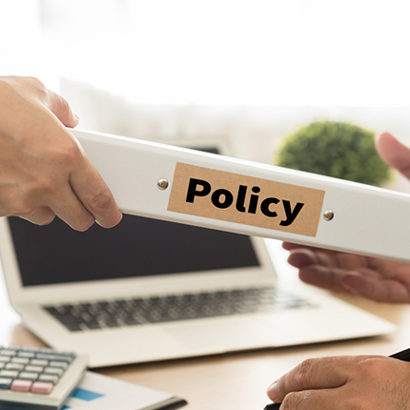
Policy Requirements (1)
As an IAO you are accountable for ensuring staff handling your information assets are aware of their obligations regarding secure handling of information, including reiterating the need for staff to complete the relevant training courses. There are specific internal policies and procedures to ensure staff understand their responsibilities and the expectations placed upon them.
As an IAO it is important that you know what your organisation's policies are on handling information to effectively minimise risks, in addition to the policies listed on the next slides:

Slide 13
Policy Requirements (2)
Acceptable use Policy
(AUP)
The AUP helps to ensure that all employees (users) with access to the organisation's information assets and systems understand their responsibilities for the appropriate and secure use of the organisation’s information technology resources (all equipment, including hardware, software and communication channels such as telephony, social media, video, email, instant messaging, internet, and intranet).
Social Media Policy
The social media policy outlines employees' responsibilities for the secure use of social media, both at home and at work. It specifies the expected behaviour of employees when engaging on social media platforms. For instance, it includes rules against posting official and sensitive information, to prevent leaks and to ensure security. The policy also aims to prevent slander, defamation, and minimise reputational damage to the organisation while encouraging employees to act responsibly and safely.
HMG Security
Classification Policy
The Government Security Classifications Policy provides an administrative system for HM Government and its partners to protect information assets against prevalent threats. Classification is based on the potential impact of the compromise, loss, or misuse of information. The policy covers procedures for creating, sharing, and destroying information, setting the baseline security controls and behaviours necessary to protect information at each classification tier.
01
02
03

Slide 14
Policy Requirements (3)
Government Functional Standard GovS 007: Security
The purpose of this government functional standard is to set expectations for protecting the government’s assets (people, property and information), visitors to government property, and third-party suppliers whilst engaged on government business and citizen data.
04
Government Functional Standard GovS 005: Digital
The purpose of this government functional standard is to set expectations for the management of digital, data and technology in government to enable defined policy outcomes, improve the usability and efficiency of government services and improve the operating effectiveness of government organisations.
05
IAO guidance:
The guidance for IAOs was refreshed in Autumn 2025 and contains the core activities and responsibilities of the IAO role For further information please visit The role of Information Asset Owners (IAOs) in government - GOV.UK.
As an IAO, it is important to collaborate with assurance, technical teams, security experts, and the data protection team, to ensure the secure handling of information within your organisation. Making sure you are visible and approachable to these teams, to effectively manage legal risks.
06

Slide 15
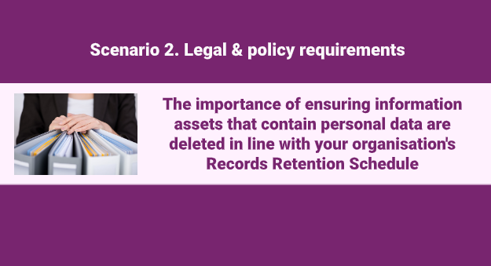
Scenario 2:
Video
Click on the image to play the Video.
If the video doesn't open in full screen automatically, click the full screen icon (⛶) in the bottom-right corner of the video player to enlarge it.
Once you have finished viewing the video click outside the image to move to the next slide.

Slide 16
You have completed this chapter
Please start chapter 6

