Slide 1
Information Asset Owner Training
Chapter 1: Information Asset Owners

Slide 2














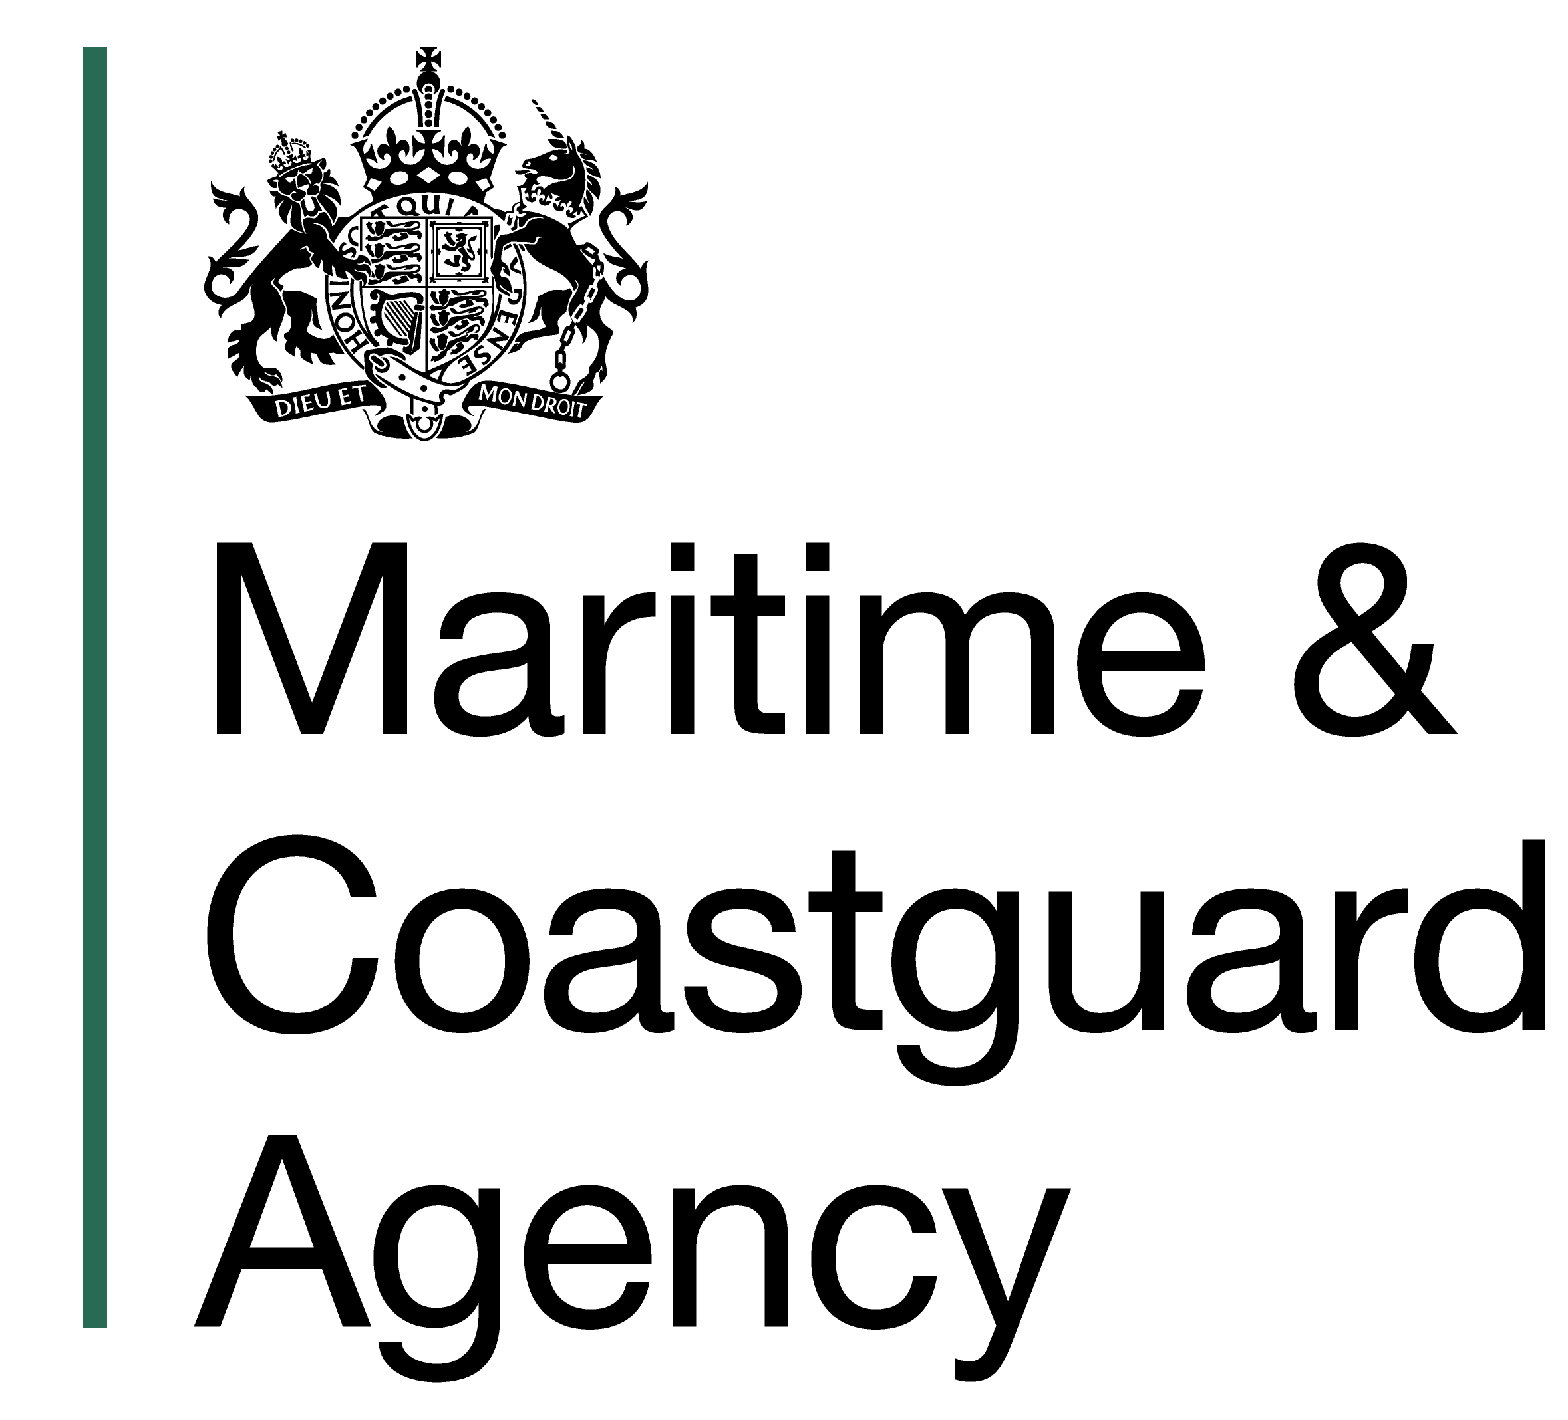



This training was developed in collaboration with our partners across government

Slide 3
Information Asset Owners
Overview
What is an Information Asset Owner?
Why do we need Information Asset Owners?
01
Role and Responsibilities – what activities do IAOs need to do?
02
1
03
04

Slide 4
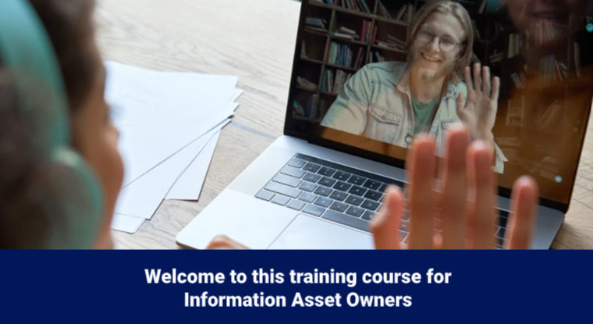
Overview
Video
Click on the image to play the Video.
If the video doesn't open in full screen automatically, click the full screen icon (⛶) in the bottom-right corner of the video player to enlarge it.
Once you have finished viewing the video click outside the image to move to the next slide.

Slide 5

What is an Information Asset Owner?
Information Asset Owners (IAOs) are senior individuals who have strategic oversight of how their organisation manages personal and critical business information, ensuring effective exploitation of information.
IAOs provide accountability for driving delivery of good practice including strategic management of information, in compliance with legal obligations, policies and standards, to reduce information risks.
IAOs form part of their organisation's information governance structure and should have access to the Accounting Officer. The IAO would usually be a Senior Civil Servant.

Slide 6
Why do we need Information Asset Owners?
Information Asset Owners:
Are accountable for the effective and ethical use and handling of information assets within their area of responsibility
Support best practice for information governance across the organisation
Ensure management of information assets in compliance with legislation and the organisation’s policies and standards
Assign Information Asset Managers to the organisation’s assets
Identify, understand and mitigate risks associated with information assets
Receive assurance from delegated teams that those responsibilities are being effectively performed
Provide formal reporting on information assets to the relevant organisation board level
Ensure security measures are in place when sharing information
Understand whether a delivery partner or supplier has access or handles information assets
Ensure staff are trained and aware of their responsibilities in protecting and managing information that they access
An information asset is a body of information, defined and managed as a single unit so it can be understood, shared, protected and exploited effectively.
Information Asset Owners provide leadership in driving a holistic and coordinated approach for the exploitation of information assets through delivery of knowledge and information management governance, compliance with legal, regulatory and policy requirements, through effective information asset management.

Slide 7
Role and Responsibilities – what activities do IAOs need to do? (1)
The role of Information Asset Owner comes with a variety of responsibilities and requirements in support of leading a culture of best practice across the organisation. This includes core activities that are essential for the effective management and protection of information assets, to ensure their value is fully utilised, contributing to the organisation's success and resilience.
The priorities and activities for Information Asset Owners, working with their Information Asset Manager and teams:
Accountability:
Maintaining clear accountability within the organisation, for the management and protection of information assets. This includes documenting responsibilities, monitoring performance, and reporting on the status of information assets. IAOs oversee decisions on use, transfer, access controls and incident reports, providing strategic direction for information assets. Accountability cannot be delegated.
Valuation:
Assessing the value of information assets to the organisation. The identification of the highest value assets and applying appropriate additional security controls. This helps in prioritising resources and efforts towards the most critical assets.
Identification and Categorising:
Identification and categorising of all information assets within the domain. This involves determining what constitutes an information asset and categorising it based on its importance, sensitivity and usage.

Slide 8
Role and Responsibilities – what activities do IAOs need to do? (2)
Risk Management: Identifying and mitigating risks associated with information assets. This involves evaluating risks, implementing mitigation measures, and monitoring for any emerging risks. Ensure information assets are managed in line with the organisation’s information risk appetite.
Security:
Implement and oversee security measures to protect information assets from unauthorised access, breaches, and other threats. This includes setting access controls, and other security protocols, including conducting regular security checks.
Information Asset Register review:
Maintain an accurate and up-to-date Information Asset Register. This includes documenting details such as the asset's location, owner, and classification and including any new assets or changes in status.
Data Usage & Access: Monitor the usage, make decisions on use, transfer, and access controls. Ensure that where needed, data sharing agreements and memorandums of understanding are in place to ensure they are being used appropriately and in compliance with legal and organisational policies.
Collaboration:
Working with other stakeholders, such as Digital, Security, Legal, and Compliance teams, to ensure a holistic approach to information asset management. This collaboration helps in sharing insights and aligning efforts and resources.
Compliance:
Reviewing and ensuring that the management and usage of information assets comply with relevant regulations, policies and standards and making necessary adjustments when needed.

Slide 9
Role and Responsibilities – what activities do IAOs need to do? (3)
Reporting: Providing regular reports on the risk status, usage and protection of information assets. This includes documenting performance, compliance, and any issues or incidents.
Breach Reporting: Engage in the management of data breaches and serious security incidents relating to information assets, along with the Data Protection Officer and Cyber and Security Teams.
Efficiency: Streamlining the management of information assets to ensure they are used efficiently and effectively. This involves optimising processes, tools, and resources to support business operations and decision-making.
Disposal: Oversee the proper disposal of information assets that are no longer needed. This includes ensuring that disposal methods comply with legal, security and regulatory requirements.
Continuous Improvement: Continuously seek ways to improve the management and protection of information assets. This involves staying up-to-update with the best practices, technologies, and regulatory changes.

Slide 10

Role and Responsibilities – what activities do IAOs need to do? (4)
These activities ensure all information assets are identified, and an accurate information asset register is maintained to understand:
What information is held?
The sensitivity and risks associated and ensure they are managed appropriately
Who has access and why?
How information is stored, used, moved, and shared
Overall, the IAO must understand the risks associated with the information assets they own and be satisfied that measures are in place to appropriately safeguard them. Ensuring full use of information within the legal, regulatory and policy requirements, ultimately providing assurances to the relevant internal information governance boards (or equivalent).

Slide 11
You have completed this chapter
Please start chapter 2

