Slide 1

Aligning Secure by Design to the Project Delivery Framework

Slide 2
Introduction
The Secure by Design approach aims to help teams deliver effective cyber security from the initial concept through every stage of a project delivering a digital service.
The change life cycles are aligned to the Government Project Delivery Functional Standard lifecycle approved by the Home Office Portfolio and Investment Committee (PIC).
The framework includes essentials for the smallest projects through to the complex mission critical and Government Major Projects Portfolio (GMPP) projects.
In these slides, we show the Secure by Design activities mapped to the Capability Delivery Framework across 3 distinct delivery types:
  programme
  waterfall projects
  agile projects
This slide deck contains visualisations. The Secure by Design guidance How to integrate Secure by Design into the government gate review life cycle provides a text alternative explaining how Secure by Design activities map to gates and decision points within the project delivery lifecycle.
References:
Government Functional Standard GovS 002: Project Delivery
HO Project Delivery Framework

Slide 3
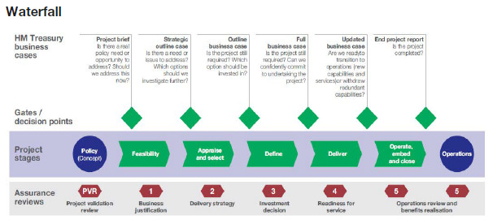
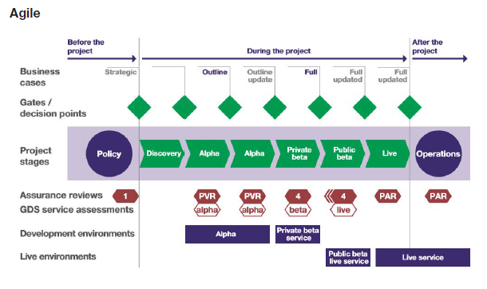
Project life cycle
The Government Functional Standard: Project Delivery defines waterfall and agile project life cycles, that are implemented in the Home Office Project Delivery Framework.
We can also deliver in a hybrid manner, depending on the needs of the organisation..
The important thing is that project stages are aligned to the business cases, which are referred to as gates or decision points.

Slide 4
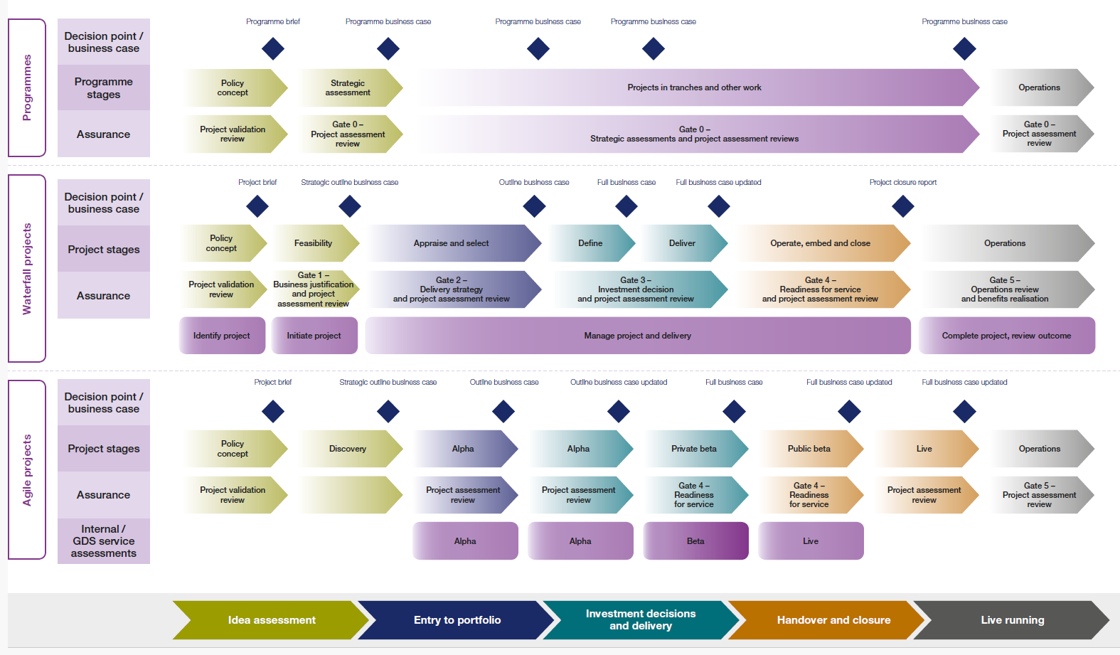
Capability Delivery Framework life cycles
The change life cycles are aligned to the Government Functional Project Delivery Standard life cycle approved by the Home Office Portfolio and Investment Committee (PIC). The framework includes essentials for the smallest projects through to the complex mission critical and Government Major Projects Portfolio (GMPP) projects.

Slide 5
Delivery life cycles (4 phases)
Private beta
Discovery
Alpha
Public beta / live

Slide 6
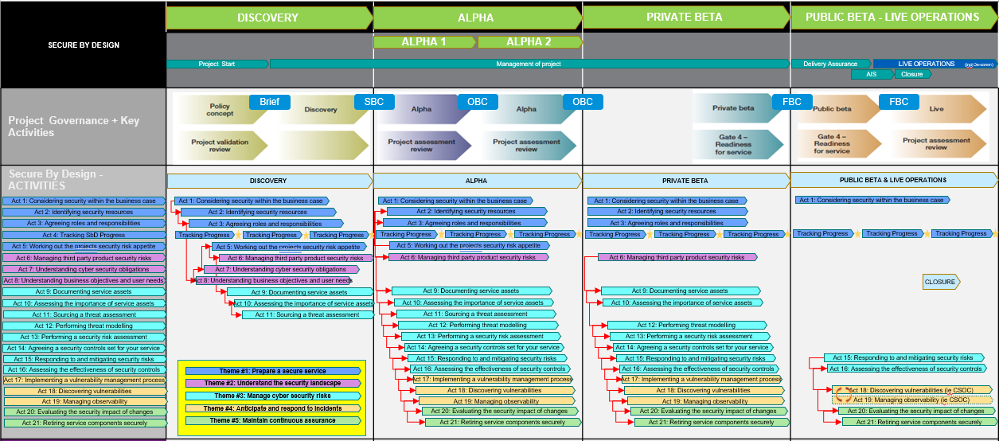
Mapping Secure by Design to delivery life cycles (4 phases)
This is a visualisation of the Secure by Design self assessment tracker (4-phase approach), which shows the activities that would be undertaken in each phase and in what order. Each of the Secure by Design activities would have a corresponding number of artefacts (documents/processes) that would be prevalent and related to that particular activity (these have been pre-mapped).

Slide 7
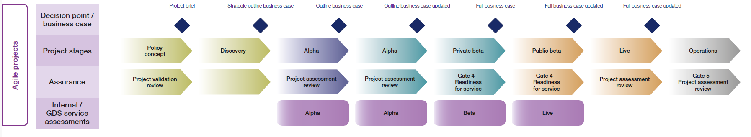
Mapping Secure by Design to delivery life cycles (Agile, 4 phases)
Private beta
Discovery
Alpha
Public beta / live
Activity 4: Tracking SbD progress Activity 4: Tracking SbD progress Activity 4: Tracking SbD progress Activity 4: Tracking SbD progress Activity 4: Tracking SbD progress Activity 4: Tracking SbD progress
Activity 1: Considering security within the business case
Activity 1: Considering security within the business case
Activity 15: Responding to and mitigating security risks
Activity 2: Identifying security resources
Activity 5: Working out the project’s security risk appetite
Activity 16: Assessing the effectiveness of security controls
Activity 3: Agreeing roles and responsibilities
Activity 2: Identifying security resources
Activity 18: Discovering vulnerabilities (i.e. CSOC)
Activity 8: Understanding business objectives and user needs
Activity 3: Agreeing roles and responsibilities
Activity 19: Managing observability (i.e. CSOC)
Activity 7: Understanding cyber security obligations
Activity 6: Managing third party product security risks
Activity 20: Evaluating the security impact of changes
Activity 5: Working out the project’s security risk appetite
Activity 9: Documenting service assets
Activity 21: Retiring service components securely
Activity 6: Managing third party product security risks
Activity 10: Assessing the importance of service assets
Activity 9: Documenting service assets
Activity 11: Sourcing a threat assessment
Activity 10: Assessing the importance of service assets
Activity 12: Performing threat modelling
Activity 11: Sourcing a threat assessment
Activity 13: Performing a security risk assessment
Activity 14: Agreeing a security controls set for your service
Activity 15: Responding to and mitigating security risks
Activity 16: Assessing the effectiveness of security controls
Activity 17: Implementing a vulnerability management process
Activity 18: Discovering vulnerabilities
Activity 19: Managing observability
Activity 20: Evaluating the security impact of changes
Activity 21: Retiring service components securely

Slide 8
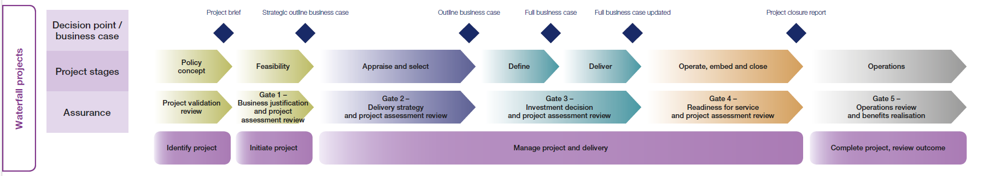
Mapping Secure by Design to delivery life cycles (Waterfall, 4 phases)
Feasibility
Appraise / define
Deliver
Readiness / live
Activity 4: Tracking SbD progress Activity 4: Tracking SbD progress Activity 4: Tracking SbD progress Activity 4: Tracking SbD progress Activity 4: Tracking SbD progress Activity 4: Tracking SbD progress
Activity 1: Considering security within the business case
Activity 1: Considering security within the business case
Activity 15: Responding to and mitigating security risks
Activity 2: Identifying security resources
Activity 5: Working out the project’s security risk appetite
Activity 16: Assessing the effectiveness of security controls
Activity 3: Agreeing roles and responsibilities
Activity 2: Identifying security resources
Activity 18: Discovering vulnerabilities (i.e. CSOC)
Activity 8: Understanding business objectives and user needs
Activity 3: Agreeing roles and responsibilities
Activity 19: Managing observability (i.e. CSOC)
Activity 7: Understanding cyber security obligations
Activity 6: Managing third party product security risks
Activity 20: Evaluating the security impact of changes
Activity 5: Working out the project’s security risk appetite
Activity 9: Documenting service assets
Activity 21: Retiring service components securely
Activity 6: Managing third party product security risks
Activity 10: Assessing the importance of service assets
Activity 9: Documenting service assets
Activity 11: Sourcing a threat assessment
Activity 10: Assessing the importance of service assets
Activity 12: Performing threat modelling
Activity 11: Sourcing a threat assessment
Activity 13: Performing a security risk assessment
Activity 14: Agreeing a security controls set for your service
Activity 15: Responding to and mitigating security risks
Activity 16: Assessing the effectiveness of security controls
Activity 17: Implementing a vulnerability management process
Activity 18: Discovering vulnerabilities
Activity 19: Managing observability
Activity 20: Evaluating the security impact of changes
Activity 21: Retiring service components securely

Slide 9
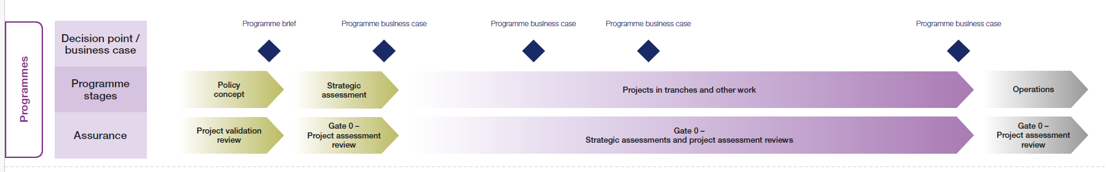
Mapping Secure by Design to delivery life cycles (Programme)
Feasibility
Project delivery
Delivery into live
Activity 4: Tracking SbD progress
Activity 1: Considering security within the business case
Activity 5: Working out the project’s security risk appetite
Activity 15: Responding to and mitigating security risks
Activity 2: Identifying security resources
Activity 2: Identifying security resources
Activity 16: Assessing the effectiveness of security controls
Activity 3: Agreeing roles and responsibilities
Activity 3: Agreeing roles and responsibilities
Activity 18: Discovering vulnerabilities (i.e. CSOC)
Activity 8: Understanding business objectives and user needs
Activity 6: Managing third party product security risks
Activity 19: Managing observability (i.e. CSOC)
Activity 7: Understanding cyber security obligations
Activity 9: Documenting service assets
Activity 20: Evaluating the security impact of changes
Activity 5: Working out the project’s security risk appetite
Activity 10: Assessing the importance of service assets
Activity 21: Retiring service components securely
Activity 6: Managing third party product security risks
Activity 11: Sourcing a threat assessment
Activity 9: Documenting service assets
Activity 12: Performing threat modelling
Activity 10: Assessing the importance of service assets
Activity 13: Performing a security risk assessment
Activity 11: Sourcing a threat assessment
Activity 14: Agreeing a security controls set for your service
Activity 15: Responding to and mitigating security risks
Activity 16: Assessing the effectiveness of security controls
Activity 17: Implementing a vulnerability management process
Activity 18: Discovering vulnerabilities
Activity 19: Managing observability
Activity 20: Evaluating the security impact of changes
Activity 21: Retiring service components securely

