Slide 1
Information Asset Owner Training
Chapter 9: Leading and fostering a culture that values, protects and uses information ethically

Slide 2

Leading and fostering a culture that values, protects and uses information ethically (1)
An Information Asset Owner (IAO) must stay informed about the strategic landscape, to understand the importance and role of information governance and security best practices. This ensures that IAO leadership is effective.
The IAO role is crucial and requires support and expertise from other subject matter experts (SMEs) and multifunctional teams, to assist in assuring information assets and implementation of core responsibilities. By ensuring that the right processes are in place for effective risk management, data protection, information governance, security and ensuring all those involved have a clear understanding of their responsibilities, the IAO can lead and foster a strong culture that values, protects and uses information ethically.

Slide 3

Leading and fostering a culture that values, protects and uses information ethically (2)
To develop a good information management culture, the IAO can help by:
Supporting the organisation to comply with information rights legislation
Reiterating the need for staff handling their assets to complete the relevant training for their organisation
Highlighting the value of their role and how they can help within their area of responsibility
Ensuring staff understand their responsibilities when it comes to information security and use
Encouraging senior leaders to consider and manage risks to information assets in their business areas
Promoting the ethical use of information
Establishing and maintaining communications within business teams about good information management practices to ensure it is embedded in business processes

Slide 4
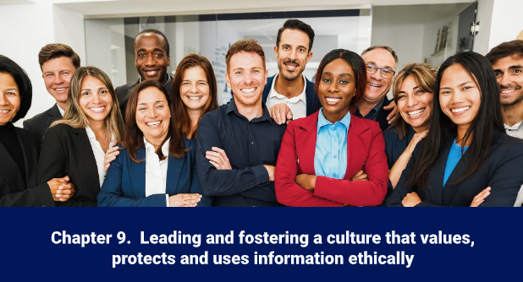
Leading and fostering a culture that values, protects and uses information ethically (3)
Video
Click on the image to play the Video.
If the video doesn't open in full screen automatically, click the full screen icon (⛶) in the bottom-right corner of the video player to enlarge it.
Once you have finished viewing the video click outside the image to move to the next slide.

Slide 5
You have completed this chapter
Please start chapter 10

