Slide 1
Information Asset Owner Training
Chapter 7: Information Risk Management

Slide 2
Information Risk Management
What is Information Risk Management (IRM)?
IRM IAO Responsibilities
Risk Assessments
What are threats and risks to information
01
How to understand the value of information to your organisation
02
Scenario 4
03
IRM Summary of key learning
04
07
05
06
07

Slide 3

What is Information Risk Management (IRM)?
IRM refers to the culture, processes and structures an organisation adopts to identify, assess, and manage potential risks to information assets. It ensures confidentiality, integrity and availability of information. The purpose of IRM is to reduce the potential for harm or loss resulting from the misuse, destruction, or unauthorised access to information.

Slide 4

IRM IAO Responsibilities
As an IAO, you are accountable and responsible for ensuring information within your area of responsibility can be used by your organisation to achieve its objectives. Both accidental and deliberate wrongful disclosure can harm the organisation's reputation and hinder its ability to function.
Managing information risk to minimise the likelihood of staff errors or intentional misuse is a crucial responsibility. This includes preventing information loss from internal/external threats, especially during information transfers, movements, or periods of business change.

Slide 5
Risk Assessments (1)
A risk assessment assesses the effectiveness and efficiency of measures to protect assets, considering policies, regulatory constraints and business objectives.
  Information assets have risks such as loss, theft, unauthorised access, leaks, and corruption. Asset identification is the foundation on which all risk management is built. It is critical to identify the different forms and classifications the information may take,
  for example:
Verbal Speech - briefings, meetings, VTC
Hardcopy documentation - meeting minutes, personnel files, briefing notes, anything that is printed
Digital - anything processed and stored on digital systems
It is also critical to identify the following:
The people who should have access to an information asset
The people who are responsible for managing the assets/platforms that process, store or transport information assets
The systems used to store, process and transport information assets
SharePoint, file transfer systems, removal media, HR systems and financial system

Slide 6
Risk Assessments (2)
As IAO the identification and management of the highest risk assets is key and knowing when to apply additional security controls to protect them.
Threat | Source or cause of risk - What can go wrong
Risk | Impacts/consequences/effects that an event can have on an organisation
Risk assessment | Overall process of risk identification, analysis & evaluation
Risk management | Coordinated activities to direct and control risk

Slide 7
Risk Assessments (3)
When assessing information risk, consider consequences if those risks were realised, including:
Financial - Direct loss of revenue to the organisation
National economic impact GDP
Societal - Welfare and economy
Reputational damage - National strategic partners/general public perception
Process corruption - Democratic process, policy and strategic decision-making
Legal/Law enforcement and criminal prosecutions/ GDPR
Physical harm - To persons identified due to compromise or unauthorised disclosure
Operational - access to systems and assets that disrupt the ability:
to deliver organisational essential services
to deliver essential services to the UK population
Loss, theft, leaking, unauthorised disclosure, or deletion of the information
If the information could be used to harm UK interests or individuals
What are the implications of failing to preserve the confidentiality, integrity, or availability of the information?

Slide 8
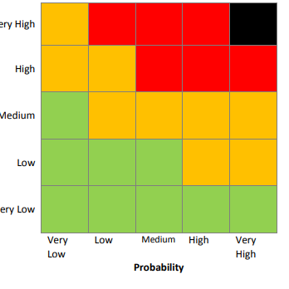
Risk Assessments (4)
Framework for Managing Risk
The Framework for Managing Risk in HM Government outlines several common methods and tools however you should follow the processes used in your organisation.
IAOs should familiarise themselves with the risk-management practices within your organisation specifically how to identify, understand, manage report and record risks. Understanding your organisation's risk appetite is also important, as it will help you to align risk-based decisions you make regarding assets for which you are responsible, within the wider organisation approach.
The most critical aspect of any risk assessment is implementing measures to ensure risks are mitigated to an acceptable level. The outcome of your risk assessment should identify the most sensitive information and the riskiest activities in terms of information handled across the organisation.

Slide 9

What are threats and risks to information? (1)
Your organisation relies on systems and technologies to handle information which is accessed by staff, partners and suppliers from diverse environments, including at home, the office, hybrid working or working overseas.
Threats to information could include a lack of appropriate measures to protect information, or from people seeking to take advantage of those vulnerabilities.
Threats to government organisations' assets includes:
Cyber criminals - ransomware is becoming increasingly widespread cyber criminals are utilising malware to incapacitate organisations for money
State Actors - may try to access technology or information for an advantage
Investigative journalists/the media - the media are interested in a story about government, often publishing that information is not being handled well
Organised Crime - criminal activity including theft and fraud
Terrorism - remains a consideration, for any government department
Single issue activists - often driven by ideology, or desire for political influence
Man-made disasters - terrorists, protest groups

Slide 10
What are the threats and risks to information? (2)
Methods of attack may include:
Phishing and Social Engineering:
techniques involve tricking individuals into revealing sensitive information or performing actions that compromise security.
Cyberattack:
malicious software, such as viruses, worms, and trojan horses, which can disrupt systems, steal data, or grant unauthorised access.
Supply Chain:
vulnerabilities in third-party systems or vendors can lead to breaches in HMG's own networks.
01
02
03
Data Breaches:
accidental or unlawful destruction, loss, alteration, unauthorised disclosure of, or access to, personal information potentially leading to loss of confidentiality, integrity, or availability of information.
Cybercrime:
criminal activity carried out using the internet, including theft and fraud.
04
05

Slide 11
What are the threats and risks to information? (3)
Methods of attack may include:
Espionage – Foreign state actors engaged in accessing UK sensitive information for geo-political or other nefarious motivations:
  State-sponsored espionage – Targeting government or critical infrastructure for geopolitical advantage
  Industrial espionage – Targeting commercial entities to gain competitive or economic advantage i.e. trade secrets, R&D and IP.
Insiders – employees, contractors or business partners, who intentionally or unintentionally misuse their legitimate access which can manifest in data breaches, data loss, or compromising critical systems.
Man-made disasters –
terrorists, protest groups.
06
07
08

Slide 12

How to understand the value of information to your organisation (1)
Understanding the value of information assets helps to assess risks and opportunities. An information asset has an identifiable and manageable value to the organisation.
Organisations may have different risk appetites for high and low-value assets. Risk appetite refers to the amount and type
of risk that an organisation is willing to accept to achieve strategic goals.
As an IAO, you can monitor risks more effectively by prioritising assets based on their value. Ensure assets within your area of responsibility are not overprotected or under-protected.

Slide 13
How to understand the value of information to your organisation (3)
These questions will help you understand the value & sensitivity of your assets:
Is it a business-critical or sensitive asset?
What is the classification?
Does the asset contain personal data and does any personal data fall into special categories?
Could your organisation function without the asset for hours/days/weeks?
Who can access the asset and who is it shared with?
If the asset is combined with another piece of information does that increase its sensitivity (aggregation)?
Does the content relate to your organisations business objectives?
Is the information already published?
Is the asset shared or created by your organisation, or by a partner?
Would there be impact on operational efficiency if it wasn’t accessible?
What organisational objectives and processes does it support?
Would loss or inappropriate access cause reputational damage to your organisation?
Would it cost to replace or repurchase the information?

Slide 14
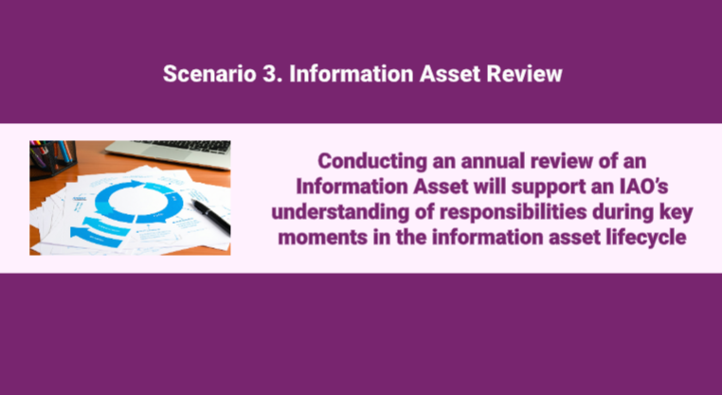
Scenario 3:
Video
Click on the image to play the Video.
If the video doesn't open in full screen automatically, click the full screen icon (⛶) in the bottom-right corner of the video player to enlarge it.
Once you have finished viewing the video click outside the image to move to the next slide.

Slide 15
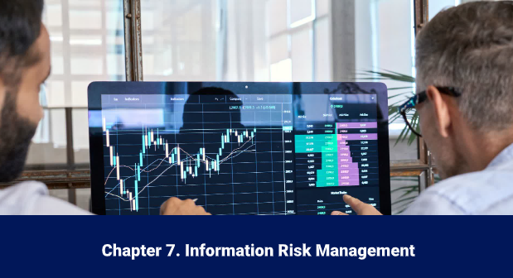
IRM Summary of key learning
Video
Click on the Computer image opposite to play the Video.
If the video doesn't open in full screen automatically, click the full screen icon (⛶) in the bottom-right corner of the video player to enlarge it.
Once you have finished viewing the video click outside the computer image to move to the next slide.

Slide 16
You have completed this chapter
Please start chapter 8

