Slide 1
Information Asset Owner Training
Chapter 3: Information Assets

Slide 2
Information Assets
What is an Information Asset
How to determine your information assets
Examples of information assets
Information Lifecycle
01
Records Management
02
03
03
04
05

Slide 3
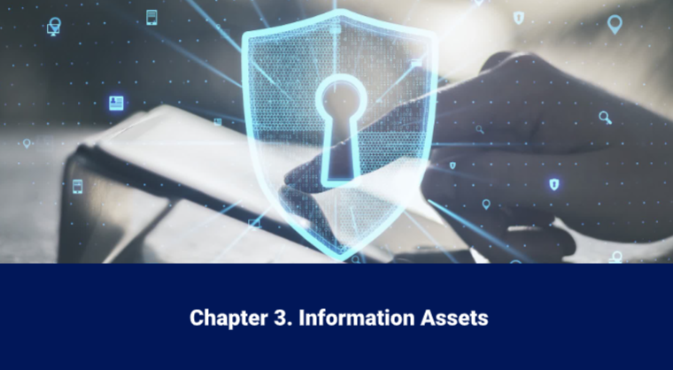
What is an Information Asset
Video
Click on the image to play the Video.
If the video doesn't open in full screen automatically, click the full screen icon (⛶) in the bottom-right corner of the video player to enlarge it.
Once you have finished viewing the video click outside the image to move to the next slide

Slide 4
How to determine your information assets (1)
An information asset is a body of information that may have one or more of these characteristics:
It has value to the organisation
It supports a business or operational process (business-critical)
It enables policy development or decision-making
It enables your organisation to keep the public or ministers informed
There is risk associated with the information
It contains sensitive or personal data
It is shared with partners
It has longevity and a lifecycle
Its loss, compromise or unavailability when required will be harmful to a business’s reputation or prevent the business from delivering its business outcome
It will have an impact on resources if it is replaced (cost, skills, time etc.)

Slide 5

How to determine your information assets (2)
Information assets are the business-critical bodies of information within your organisation, the kind of information that, if it became lost, stolen, corrupted, modified, or unavailable, it would cause significant impact to your organisation's reputation and/or delivery outcomes.
An information asset is not a system or database. The information that is held on the system or database is the information asset and there may be multiple information assets held in a single system.
Information assets that are hosted or handled externally by a third party are still under the ownership and management of the organisation and therefore the IAO is accountable for those information assets within their area of responsibility and must ensure they are handled securely.
Information assets should be grouped based on content and consideration should be given to their business needs, not their technical requirements.

Slide 6
Examples of information assets
Information assets could be:
Collection of citizen or patient records
Local database containing specific information such as payments or budgets
HR files and folders which include personal data
Set of data subject records on a system – personal data sets being routinely managed/used
Policy formulation documents and communications related to a subject
Database of related information e.g., Financial or Commercial
Statistical information e.g., group of linked spreadsheets
A collection of documents on a subject for a specific purpose regarding business operations
A set of administration files where your organisation has lead responsibility
Information required to be maintained by law
Information assets are not:
Physical Hardware such as laptops/ desktops
IT systems can host different types of information assets, or process information for different business purposes

Slide 7

Information Assets
All information associated with a specific project (such as reports, digital records, documents, images, emails, photo images, sound /voice recordings and any other form of digital records) can be grouped together and treated as a single asset, as they have similar definable content and the same value, business risk and lifecycle.
A list of contacts held on a database must be grouped as a single asset. The usage will have a single business purpose and joint risks associated with privacy and storage of personal information. Therefore, each entry does not need to be treated individually and can be considered jointly as a single information asset.
Where an information asset comprises a collection of information with a range of different sensitivities or security classifications, the highest security level present in the collection will be ascribed to that asset to identify the security level required. Consideration also needs to be given to differing retention periods, handling instructions and descriptors.

Slide 8
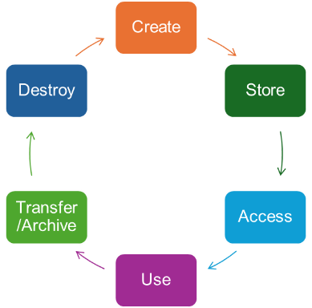
Information Lifecycle (1)
Information lifecycle management is the consistent management of information from creation to final disposal. It is comprised of strategy, people, process, and technology to effectively manage information which, when combined, drives improved control over information assets within the organisation.
The lifecycle of an information asset encompasses several stages: creation, storage, access, use, transfer/archiving, and eventual destruction. Each phase should be managed effectively to ensure the asset is protected and handled securely (with integrity, confidentiality, and availability).

Slide 9






Information Lifecycle (2)
Create
During the creation phase, data is generated or acquired, requiring classification based on sensitivity.
Store
It is then stored securely, using appropriate systems that protect against unauthorised access or loss.
Access
Controlled access ensures that only authorised individuals can retrieve or modify the asset, supporting accountability and compliance.
Use
The use phase involves leveraging the asset to support business operations, decision-making, or service delivery, while maintaining its accuracy and relevance.
Transfer/Archive
During the lifecycle it is crucial to implement measures to minimise risk, ensure regulatory compliance, and maximise the value of information assets throughout their existence.
Destroy
When the asset is no longer actively needed, it may be transferred or archived for long-term retention, ensuring it remains retrievable and protected.

Slide 10

Records Management (1)
Storing, and naming information assets
Government organisations must maintain accurate administrative records ensuring that they are accessible for public review. Information should be managed from its creation to its disposal. Business-critical information necessary for understanding the administration of an organisation must be properly saved and stored as corporate records. These records are maintained in registered files.
Good information governance involves:
Establishing common naming conventions for files and documents to ensure better access and understanding of information assets
A structured system for naming files, makes them easy to identify and organise
It ensures consistency for describing documents' content, helping to identify relationship to other files, saves time searching, and reduces risk of data loss or misplacement. It also aids in identifying assets for the information asset register (IAR).

Slide 11

Records Management (2)
Storage
When assets reach the end of their useful life, organisations must consider disposing of information in line with their retention and disposal schedule. Where information forms a record, then consideration needs to be given to archiving and the Public Records Act 1958. The Act mandates that public authorities are responsible for selecting which records are permanently valuable and should be preserved. Records selected for permanent preservation are transferred to the National Archives (TNA). Any information that does not warrant preservation must be securely destroyed to prevent data breaches or misuse.
Records can be in any format. For example, email, paper, electronic, sound recording. Records can be a single document or a group of documents with a common unique theme. It is the content that makes a document a record, not the format.

Slide 12
Records Management (3)
Corporate records
Corporate records - must be stored in registered files to maintain information integrity and document decision-making, policy development, expenditures, and support any legal challenges. Staff must record their decisions, advice, and actions, especially those classified as corporate records. The information author/owner should ensure that all information is handled in accordance with the organisation’s Information Management Policy and supporting guidance.
Documents that have been identified as an important corporate record must be kept as follows:
Registered Files
This is the formal paper-based system used to control and manage the most significant corporate records, which include those considered significant in terms of public interest, spending, or have a potential national impact.
E-Registered Files
These are electronic versions of a paper registered file. If used, there is specific guidance these are to be kept and maintained to ensure the integrity of the information is preserved.
Corporate Record Boxes
These are used for bulky records that would otherwise be held in a registered file, for example finance, legal, estates and procurement documents.
Your organisation will have their own records management and storage process in place.
Please check with your organisation DRO for further information.

Slide 13
You have completed this chapter
Please start chapter 4

