Slide 1
Information Asset Owner Training
Chapter 10: Information Governance

Slide 2

Information Governance (1)
Overview
An Information Asset Owner (IAO) will usually work to the Accounting Officer, who would often be the Permanent Secretary or Chief Executive of the department/organisation and will work closely with the Departmental Records Officer (DRO), the Senior Information Risk Owner (SIRO), the Data Protection Officer (DPO) and Data Owners to ensure that duties are properly coordinated and assurances are provided to the relevant internal information governance boards (or equivalent).
The specific mechanisms of how these relationships operate will be up to the individual organisation as not all departments will have all of the roles mentioned and, in some cases, the same person may be carrying out the responsibilities of more than one named role.

Slide 3






Information Governance (2)
Roles and responsibilities
The Accounting Officer
has overall responsibility
for ensuring that the information risks are assessed and mitigated to an acceptable level.
Data Protection Officers
(DPO) assist organisations
to monitor internal compliance, inform and advise on their data protection obligations, provide advice regarding Data Protection Impact Assessments (DPIAs) and act as a contact point for data subjects and the Information Commissioner’s Office (ICO).
The senior person
accountable for
information security risk, (sometimes called the SIRO) plays the main role in the management and protection of the organisation's information assets, with a particular responsibility for information risk.
Departmental Record
Officers (DRO) lead on compliance with the Public Records Act and play an important role in the management of information within government departments.
Data Owners are senior individuals who are the
dedicated owner of a logical grouping of data, and have
in-depth insights into the overall business strategy in their data remit.
Information Asset
Manager (IAM) is a
delegated role working on
behalf of the IAO, with regular responsibility for the proper management of information in their business area.

Slide 4
Information Governance (3)
Information Asset Owner
Accounting Officer
Data Protection Officer
Data Owner
Information Manager
Knowledge and Information Management Teams
Digital and Data Teams
Information Asset Manager
Knowledge Managers
Records Managers
Cyber Teams
Security Teams
Senior Information Risk Owner
Departmental Records Officer
Roles and responsibilities
An IAO will also work closely with, and seek advice from, their knowledge and information management teams, digital and data teams, cyber and security teams and data protection teams.

Slide 5
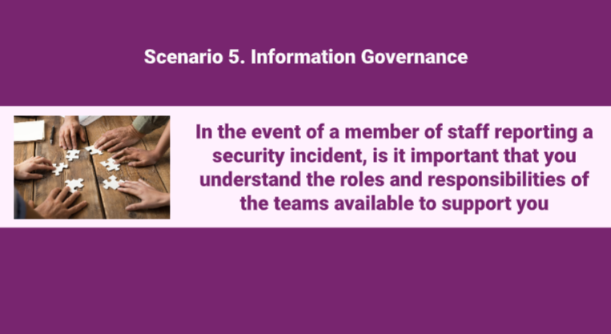
Scenario 5:
Video
Click on the image to play the Video.
If the video doesn't open in full screen automatically, click the full screen icon (⛶) in the bottom-right corner of the video player to enlarge it.
Once you have finished viewing the video click outside the image to move to the next slide.

Slide 6
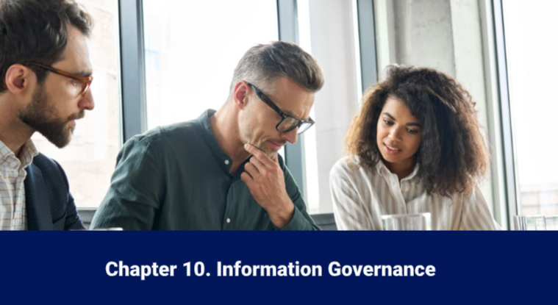
Information Governance (4)
Video
Click on the image to play the Video.
If the video doesn't open in full screen automatically, click the full screen icon (⛶) in the bottom-right corner of the video player to enlarge it.
Once you have finished viewing the video click outside the image to move to the next slide.

Slide 7
You have completed this chapter
Please continue to the knowledge checker

Slide 8






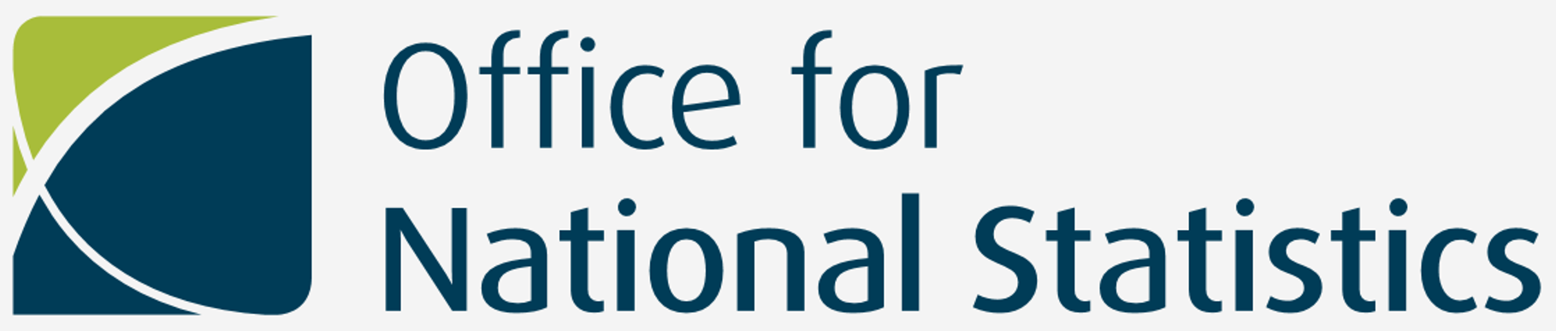




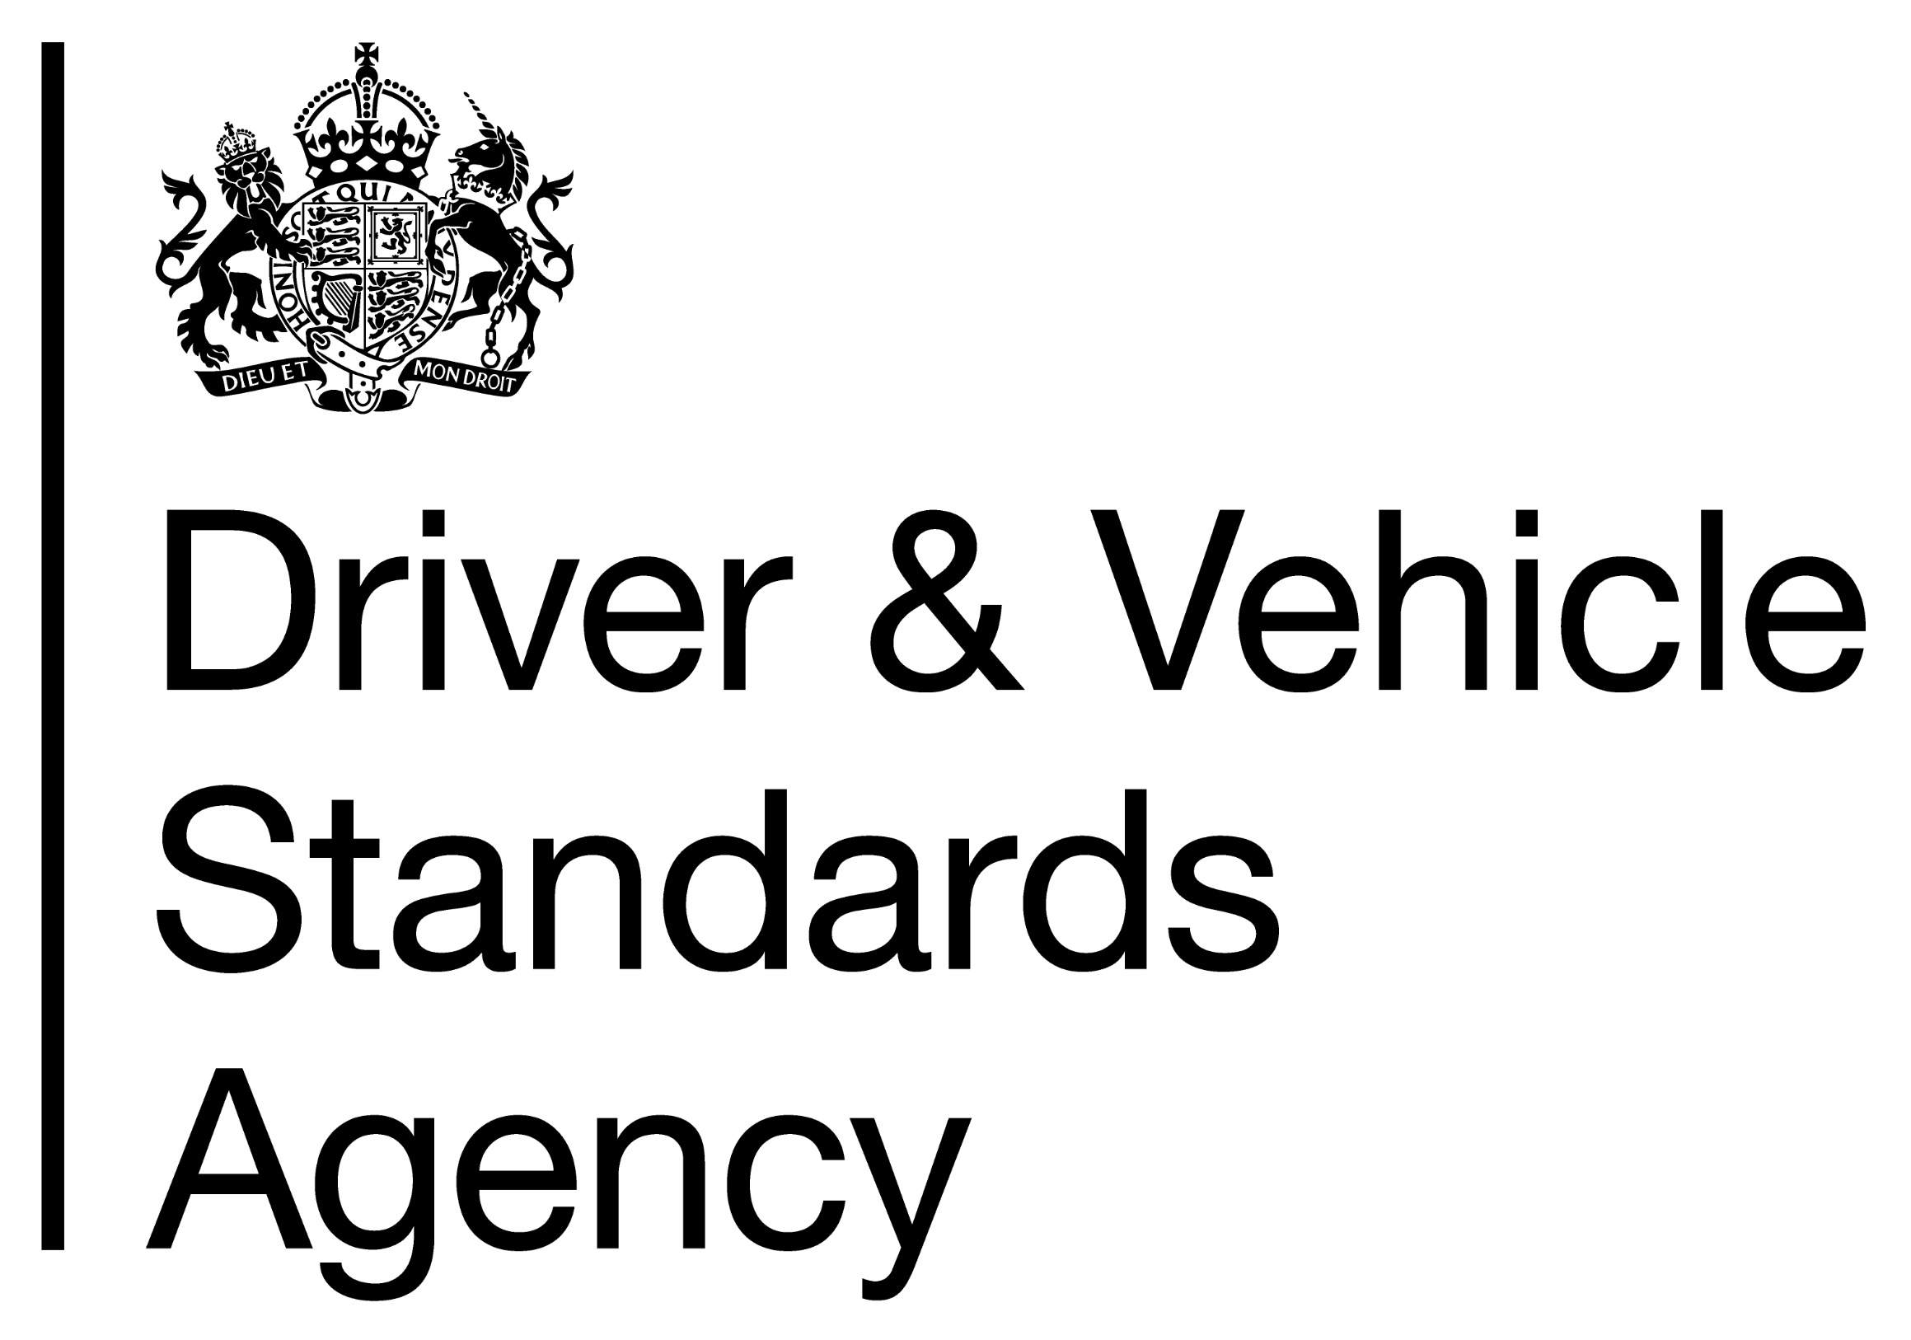
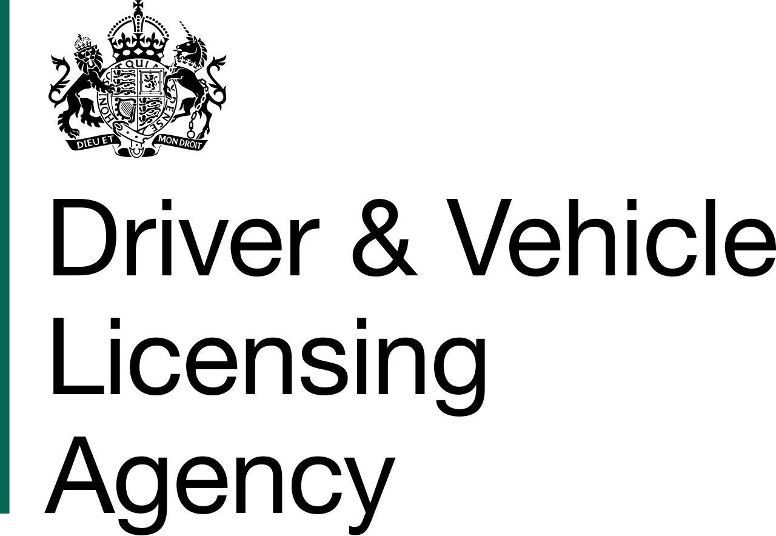


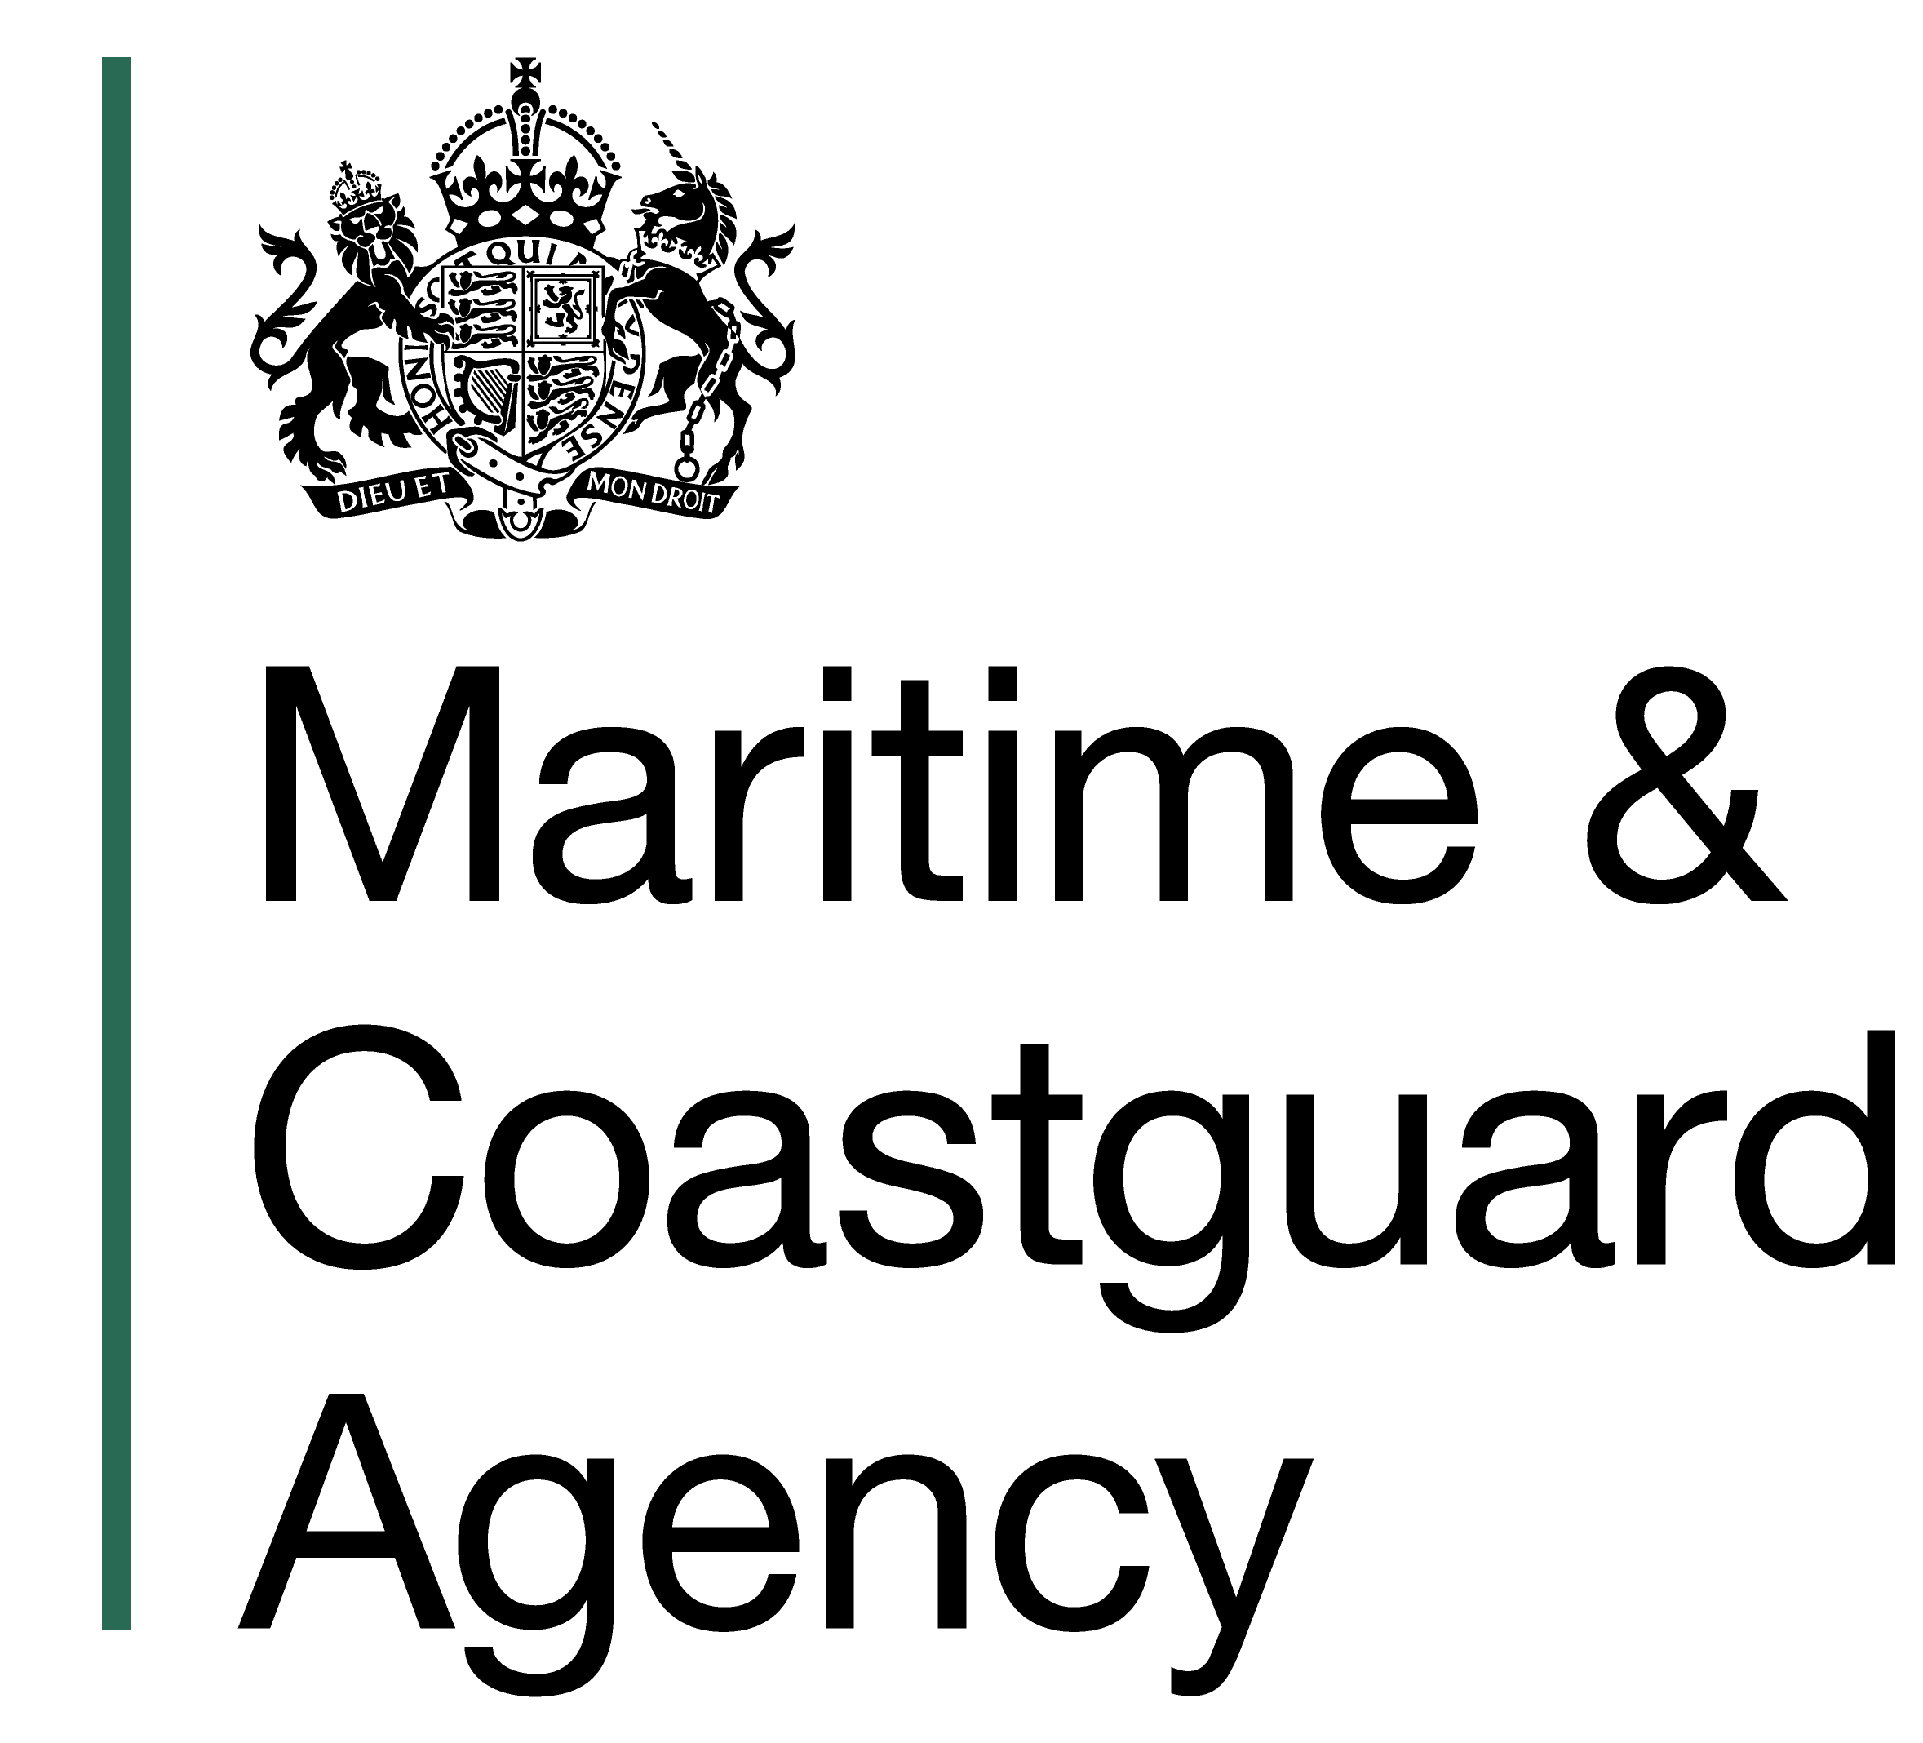


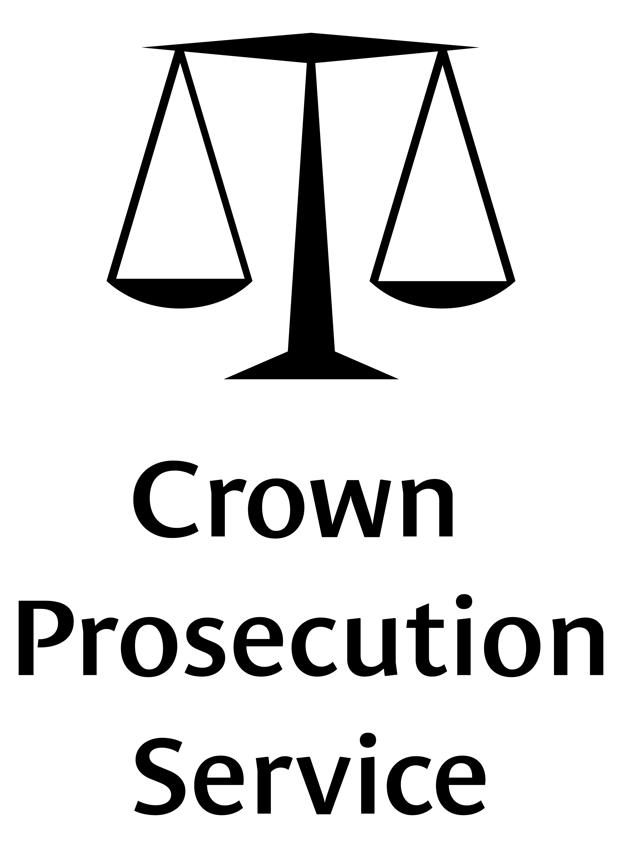
This training was developed in collaboration with our partners across government

