Slide 1
Cyber Assessment Framework for local government executive reporting:
NE Council
17 January 2025

Slide 2
Contents
Overview of security posture
How we approached this work
Overview of cyber resilience and risks
High level findings
Recommendations for improvement
Improvement and implementation plan

Slide 3
Our security posture assessment
A summary of where NE Council is currently meeting the CAF for local government profile.
NE Council was assessed against the baseline CAF profile for local government that councils are encouraged to aim for.
Blue – Have met CAF profile
We have met or exceeded all of the contributing outcomes supporting the CAF principle
Orange – Have not met CAF profile
We have not met one or more of the contributing outcomes supporting the overall CAF principle
Governance
CAF for
local government
Objective
Principle

Slide 4
Overview of our security posture
During the independent assurance review of the NE Council’s security posture, it was noted:
NE Council has the required policies, processes and procedures in place which govern our approach to cyber security, but further work is required to embed them into our organisational culture' - which aligns with Objective A requirements.
The assessment identified gaps in the identity and access control process, revealing that privileged access is not consistently restricted to corporately managed devices dedicated to management functions, as required by Objective B.
The assessment has identified that NE Council do not have a monitoring service, as per Objective C requirements, which would alert us to cyber attacks, therefore our critical systems may be compromised without us being aware.
NE Council’s incident response capability is not well defined, as per the CAF requirements of Objective D, or understood across the organisation, creating a risk that we may not be able to respond effectively to a cyber incident.

Slide 5
Our top five high level risks
Objective | Risk | Description of risk
A - Managing security risk | Lack of executive support | Insufficient backing from senior leadership can result in poor resource allocation, underfunding of security initiatives, and a lack of strategic direction for the organisation's information security efforts.
 | Resistance to change | In a culture resistant to change, employees may be reluctant to adopt new security technologies or processes, hindering the organisation's ability to keep pace with evolving threats and leaving outdated systems vulnerable.
B - Protecting against cyber attack | Insufficient identity and access control processes | Gaps in the identity and access control process, where privileged access is not consistently restricted to corporately managed devices dedicated to management functions, pose a significant security risk. This could lead to unauthorised access, potential data breaches, and compromised critical systems, ultimately undermining the integrity and security of sensitive information and operations.
C - Detecting cyber security events | Undetected cyber attacks | Without a monitoring service in place as required by Objective C, the Council faces a significant risk of undetected cyber attacks. This lack of real-time alerts could result in critical systems being compromised, leading to potential data breaches, service disruptions, and damage to the Council’s reputation, all while the threat remains unnoticed and unaddressed.
D - Minimising the impact of incidents | Lack of incident response processes | The lack of a well-defined and widely understood incident response capability, poses a significant risk to the Council. In the event of a cyber incident, the Council may be unable to respond effectively, leading to prolonged service disruptions, increased damage, potential data loss, and reputational harm due to the inability to contain and mitigate the impact of the incident.

Slide 6
Improvement and implementation plan roadmap
One year roadmap | January | February | March | April | May | June | July | August | September | October | November | December
Managing security risk (objective A)
Protecting against cyber attacks (objective B)
Detecting cyber security events (objective C)
Minimising the impact of cyber security attacks (objective D)
R1: Senior leadership should prioritise information security by making it a standing agenda item in executive meetings, ensuring proper resource allocation, and aligning security goals with the organisation's strategy. This will improve funding, strategic direction, and risk management.
R2: Encourage a culture of adaptability by promoting the benefits of new security technologies and processes, providing training, and involving employees in change initiatives to ensure systems stay up-to-date and resilient against evolving threats.
R3: Implement strict access controls to ensure that privileged access is consistently restricted to corporately managed devices. This includes establishing and enforcing policies that mandate the use of approved devices for accessing sensitive systems and regularly auditing access practices to prevent unauthorised access and protect the integrity and security of the Council’s essential functions.
R4: Ensure cyber security policies and standards are fully embedded in all processes and systems supporting essential functions.
R5: A full review of relevant existing policies should be performed, and a schedule put in place for future reviews
R6: Develop requirements for a protective monitoring service, including a Managed SIEM, Incident response support, enterprise forensics and E-Discovery.
R7: Identify a preferred partner for a managed SOC service and formalise arrangements (contract, SLA, OLAs etc)
R8: Onboard assets to the monitoring regime, addressing identified vulnerabilities accordingly.
R9: Develop an Incident Response Plan, ensuring that all relevant stakeholder groups are consulted (IT, Cyber, Legal, Service Leads, Comms, SLT, SIRO etc) and the document is formally approved.
R10: Undertake periodic Table Top exercises to test the effectiveness of the plan, using lessons learnt to continually improve the content.
Legend:
High-risk level
Medium-risk level
low-risk level

Slide 7
Key decisions
We need NE Council’s senior leadership and management team to:
Confirm how information security will be prioritised and included as an agenda item in executive meetings to ensure proper resource allocation, and aligning security goals with the organisation's strategy - identify next steps and agree with key stakeholders.
Sponsor a near term initiative to review and update the current security and awareness training, with a long term plan commissioning a new comprehensive information security training solution.
Sponsor resources to develop and enforce policies that mandate privileged access to corporately managed devices, conduct regular audits to ensure compliance, provide training for staff and continuously monitor and adjust access controls to maintain the security and integrity of NE Council’s essential functions.
Sponsor a project to define the requirements for a protective monitoring service, including Managed SIEM, incident response support, enterprise forensics, and e-Discovery; select a preferred managed SOC partner, finalise contractual arrangements, and onboard assets to the monitoring regime while addressing identified vulnerabilities.
Formally approve the Incident Response Plan, ensuring input from all relevant stakeholders (IT, Cyber, Legal, Service Leads, Comms, SLT, SIRO), and sponsor regular Table Top exercises to test and refine the plan based on lessons learned.

Slide 8
Next steps
NE Council will have internal discussions to review and socialise the improvement and implementation plan.
NE Council to develop a detailed implementation plan for the recommendations based on priority and funds available, specifying dependencies and assumptions.
NE Council to get sign off on improvement plan by senior leadership and management team.

Slide 9
Annex
More detailed information about NE Council’s CAF assessment

Slide 10
How we approached this work

Slide 11
How we approached this work
Our council completed a self assessment of our organisation and critical systems to assess our cyber resilience.
An independent review of our council’s self assessment has been carried out, based on evidence we have provided. (Full assurance report available separately.)
The standard NCSC Cyber Assessment Framework (CAF) v3.2 was used as the assessment framework for this work.
Following the independent assurance review and discussions with the assurers, this presentation summarises our key findings and recommendations. These recommendations are based on actions that need to be taken in order to meet the local government profile for the CAF.
It is important to note that whilst the CAF has been designed by the NCSC to assess cyber security, fully meeting the CAF does not completely remove the risk of a future cyber-attack. It will help increase cyber resilience, thereby reducing the risk and impact of a cyber-attack.

Slide 12
Overview of cyber resilience and risks

Slide 13
Managing security risk (objective A) risks
Principle | Total number of risks identified | Description of high level risks
A1 - Governance | 6 (2 High Risk) | Lack of Executive Support - Insufficient backing from senior leadership can result in poor resource allocation, underfunding of security initiatives, and a lack of strategic direction for the organisation's information security efforts. Resistant to change - In a culture resistant to change, employees may be reluctant to adopt new security technologies or processes, hindering the organisation's ability to keep pace with evolving threats and leaving outdated systems vulnerable.

Slide 14
High level findings
This section includes potential ways you could present your findings visually to your senior leadership and management team.

Slide 15
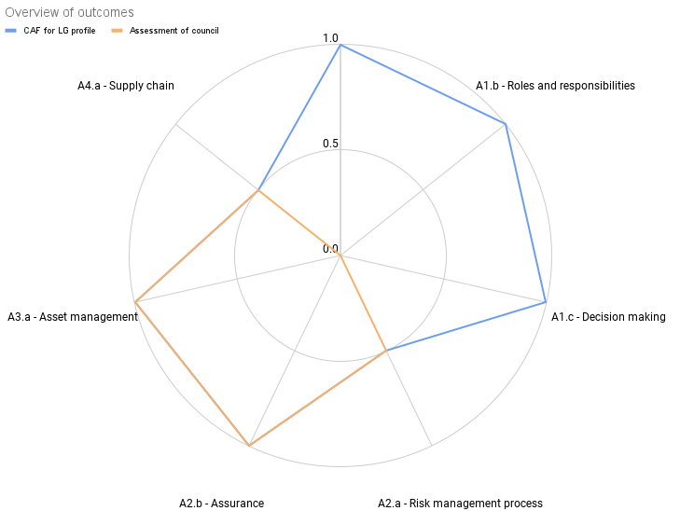
NE Council’s achievement level - objective A (option 1)
Most IGPs have been assessed as meeting the required CAF Profile, highlighting several strong practices that NE Council has successfully implemented and can further develop.
Improvements in Governance are necessary (as outlined in the provided recommendations) to fully align with the CAF Profile requirements.
Further details are available in the full assurance report.

Slide 16
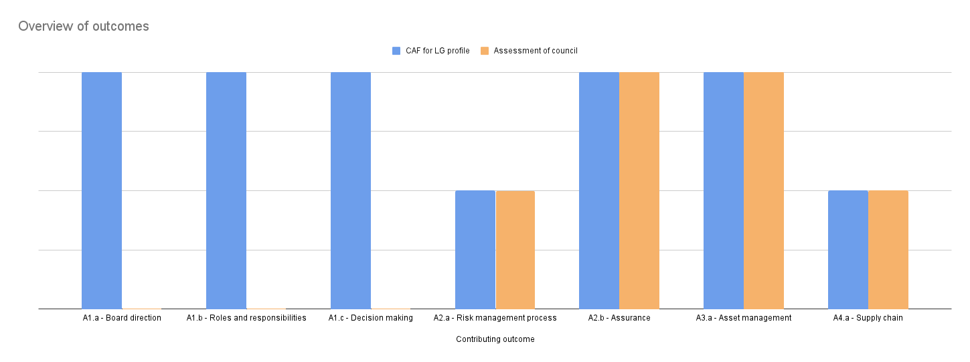
NE Council’s achievement level - objective A (option 3)
Most IGPs have been assessed as meeting the required CAF Profile, highlighting several strong practices that NE Council has successfully implemented and can further develop.
Improvements in Governance are necessary (as outlined in the provided recommendations) to fully align with the CAF Profile requirements.
Further details are available in the full assurance report.

Slide 17
Recommendations for improvement

Slide 18
Managing security risk (objective A) recommendations
Principle | Total number of recommendations | Recommendations
A1 - Governance | 6 (2 High risk) | Senior leadership should prioritise information security by making it a standing agenda item in executive meetings, ensuring proper resource allocation, and aligning security goals with the organisation's strategy. This will improve funding, strategic direction, and risk management. Encourage a culture of adaptability by promoting the benefits of new security technologies and processes, providing training, and involving employees in change initiatives to ensure systems stay up-to-date and resilient against evolving threats.

Slide 19
Improvement and implementation plan

Slide 20
Our approach to creating the plan
Our improvement and implementation plan was driven by the risks assurers identified during our CAF self assessment.
It’s based on recommendations we have prioritised, and includes the risk rating provided as part of the assurance process.
We have made some estimates to cost and effort for our improvement plan.
We have set out a roadmap to show our proposed schedule for our improvement plan and the recommendations that will be implemented in the upcoming year.

Slide 21
Improvement and implementation plan roadmap (objective A)
One year roadmap | January | February | March | April | May | June | July | August | September | October | November | December
Managing security risk (objective A)
R1: Senior leadership should prioritise information security by making it a standing agenda item in executive meetings, ensuring proper resource allocation, and aligning security goals with the organisation's strategy. This will improve funding, strategic direction, and risk management.
R2: Encourage a culture of adaptability by promoting the benefits of new security technologies and processes, providing training, and involving employees in change initiatives to ensure systems stay up-to-date and resilient against evolving threats.
Legend:
Low-risk level
Medium-risk level
High-risk level
Legend:
Low-risk level
Medium-risk level
High-risk level

Slide 22
Managing security risk (objective A)
Principle | Number of recommendations | Ownership / role(s) responsible | Cost | Effort (High/Medium/Low) | Complexity (High/Medium/Low) | Implementation priority
A1 - Governance | 6 (2 High risk) | Senior leadership team (SLT) SIRO IT and cyber teams | TBC | Low | Medium | High
A2 - Risk management
A3 - Asset management
A4 - Supply chain

Slide 23
Recommendations not implemented (objective A)
Recommendation
Continue to formalise the corporate risk management framework and policy and set the risk appetite. Ensure this is implemented at Directorate level and supported by more focused risk management and registers
Risk
Lack of formally defined corporate risk management framework and policy could lead to inconsistent risk management practices, unclear risk tolerance, and inadequate identification and mitigation of risks across different departments. Without a formalised framework and policy, the Council may not be able to prioritise risks appropriately, leading to delayed responses to emerging threats, increased vulnerability to unexpected events, and potential non-compliances with regulatory requirements.
Why NE Council is not implementing this
This recommendation has already been actioned by the council and is currently underway due to be completed within the current quarter, so no further action is required.

