Slide 1
GovAssure ‘dashboard’ dial graphic
For inclusion in GovAssure Independent Assurance Review Reports

Slide 2
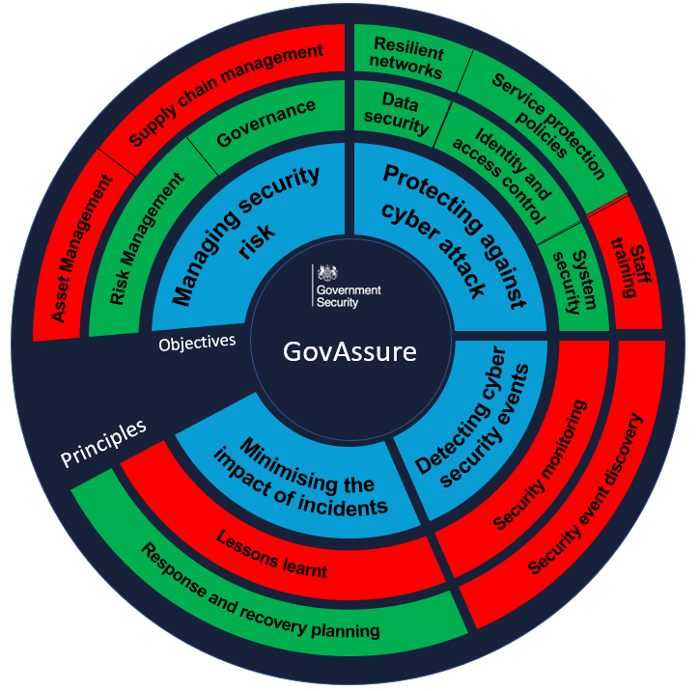
Editing the GovAssure ‘dashboard’ dial for inclusion in GovAssure reports
The infographic has been designed with Executive level members in mind to bring contributing outcomes up a level to provide a visual as to where contributing outcomes are either supporting achievement of security principles or to identify where there are control gaps leading to security principles being let down by contributing outcomes not meeting the respective target CAF government profile on a system level basis.
It reports on the basis of ‘met’ or ‘not met’ in respect of the target government CAF profile. For example, if contributing outcomes under the ‘Governance’ profile have not met the target defined profile, then the principle should be colour coded ‘red’ to represent contributing outcome not being ‘met’. If all contributing outcomes have met target, then this should be colour coded ‘green’ to represent achievement of the overall principle, ‘met’.
The GovAssure dashboard dial is designed to be customised based on the results of the Assurance Review – either copy and paste, or snip and copy and paste in to this Word document.
The per system dial should be duplicated within the respective system section of the Part C: Detailed Findings to allow for this section to be extracted and issued on a need to know basis.
Crib sheet guidance on completing a contributing outcome on WebCAF

Slide 3
Editable version
Governance
Objectives
GovAssure
Principles

